Slide 1

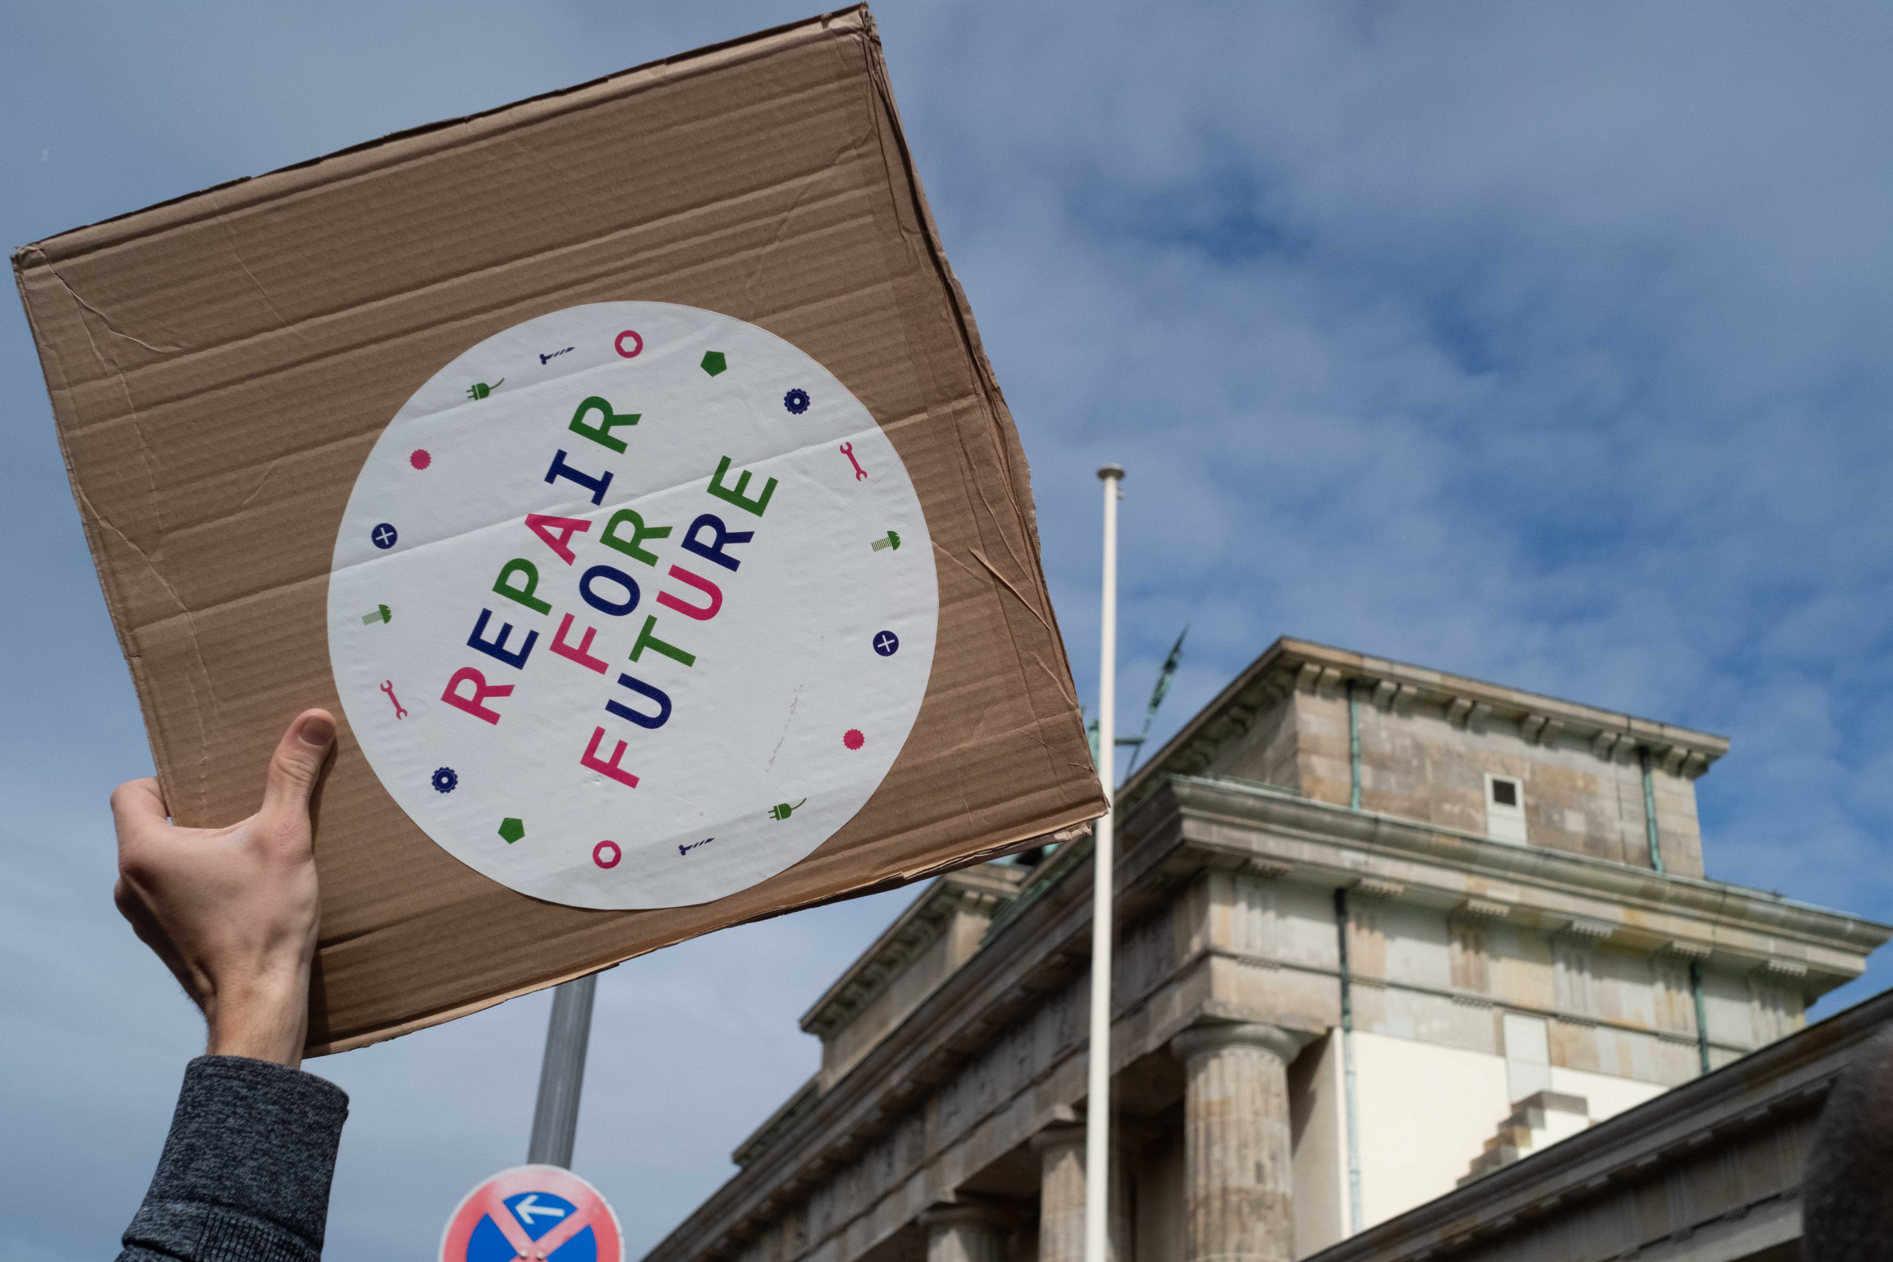
Repair in Europe’s cities
Katrin Meyer and Alena Romanova
Runder Tisch Reparatur e.V.
(c) Mark Phillips

Slide 2
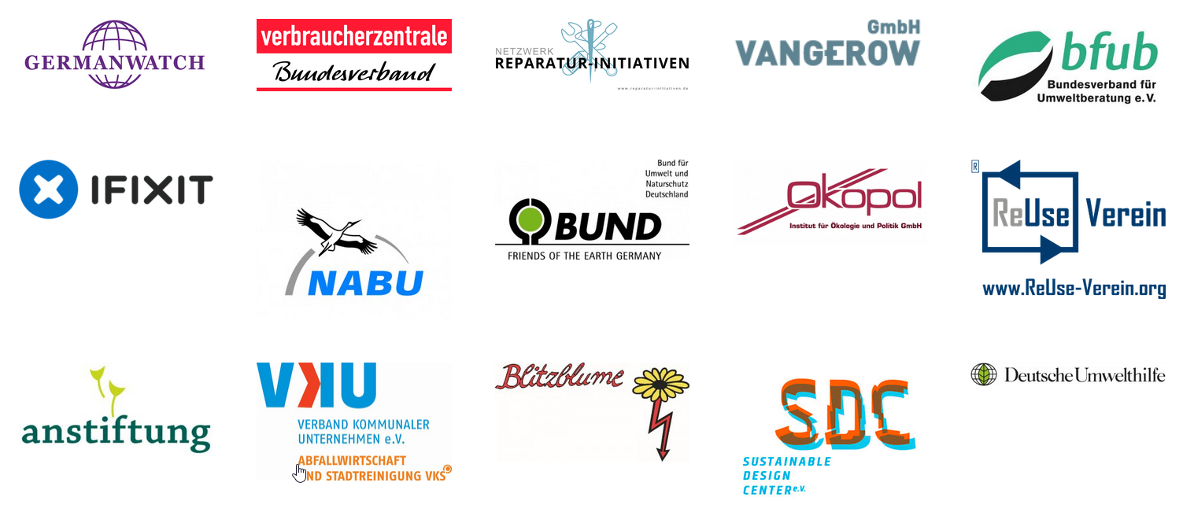
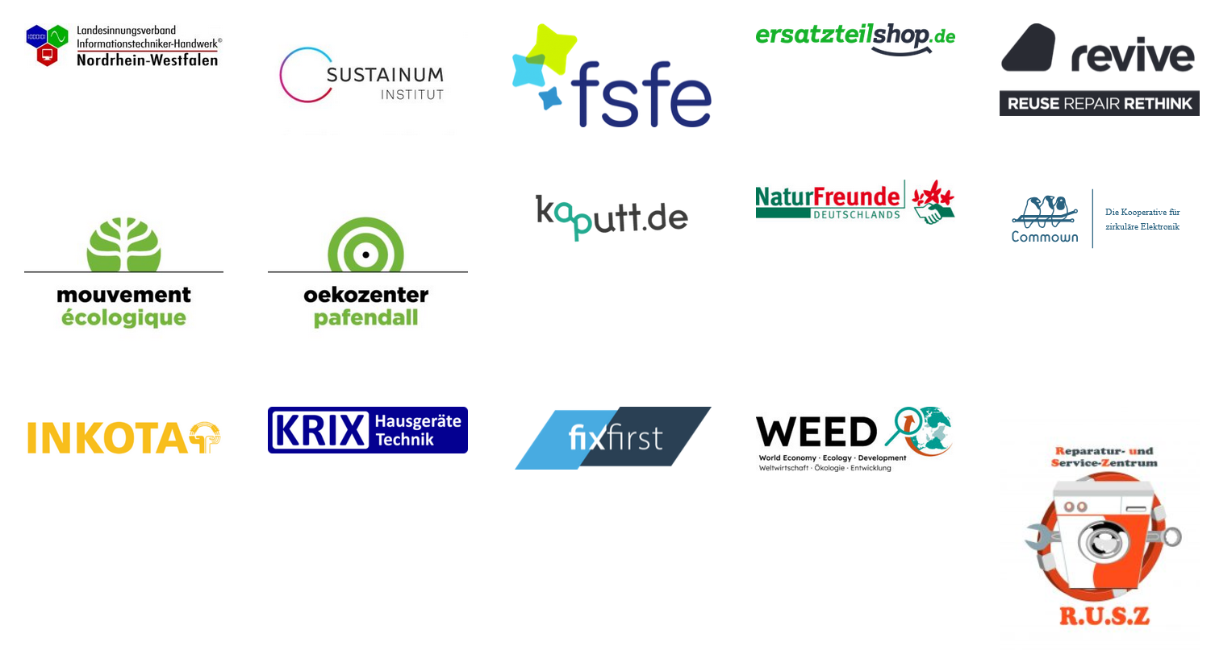


Runder Tisch Reparatur (Round Table Repair)
Working on a right to repair since 2015
We are: Community and professional repairers, environmental and consumer organisations, refurbishers, scientific institutions,…
Repair is essential for
Environmental, climate and resource protection
consumer rights
and local economic development
Right to Repair Europe campaign with European partners

Slide 3
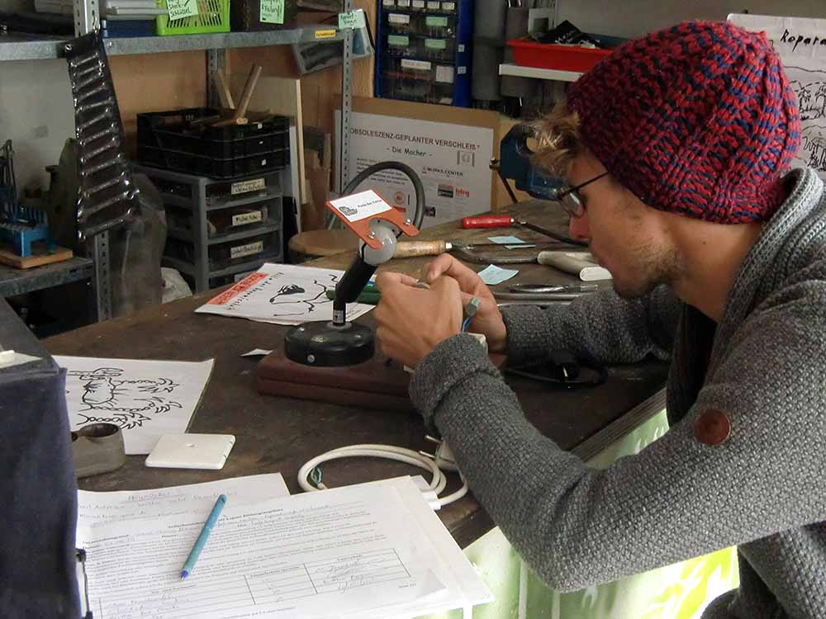
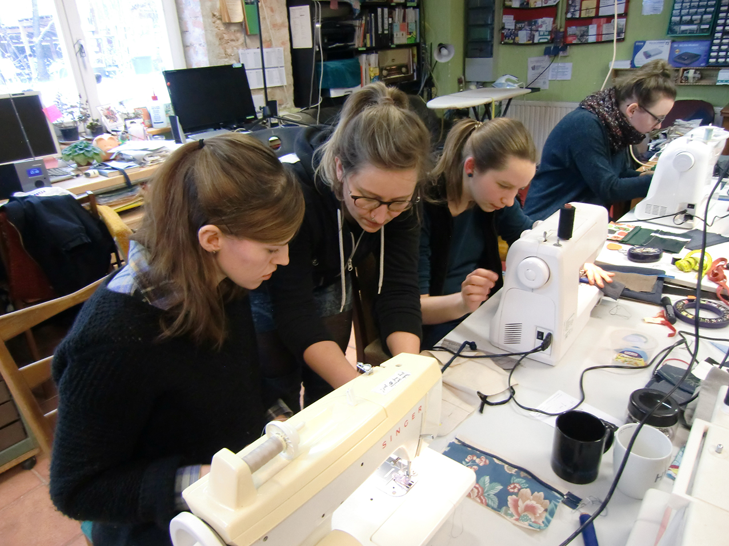
People want to repair
‚There is more community repair
than ever before‘ -
Source: “The rise of community repair: the people and the data building a movement“, Open Repair Alliance, 2024
©Café Kaputt
77 % of Europeans say they are making an effort to get broken appliances repaired before buying new ones
Source: Flash Eurobarometer 388
©Café Kaputt

Slide 4
People want to repair - but it‘s difficult
The three most common reasons for not repairing:
High costs
Wants a new model
Too complicated
Source: vzbv 2017: https://www.vzbv.de/sites/default/files/downloads/2017/06/01/umfrage_-_haltbarkeit_und_reparierbarkeit_von_produkten_o_gewaehrleistung.pdf
NIM 2025 https://www.nim.org/fileadmin/PUBLIC/3_NIM_Publikationen/NIM-Studien/NIMpulse/2025/250704_NIMpulse_11_-_Reparierbarkeit_fin.pdf
©Café Kaputt

Slide 5
The pillars of a right to repair
Access to information
Access to affordable spare parts
Repairable products (design + no software blocks)

Slide 6
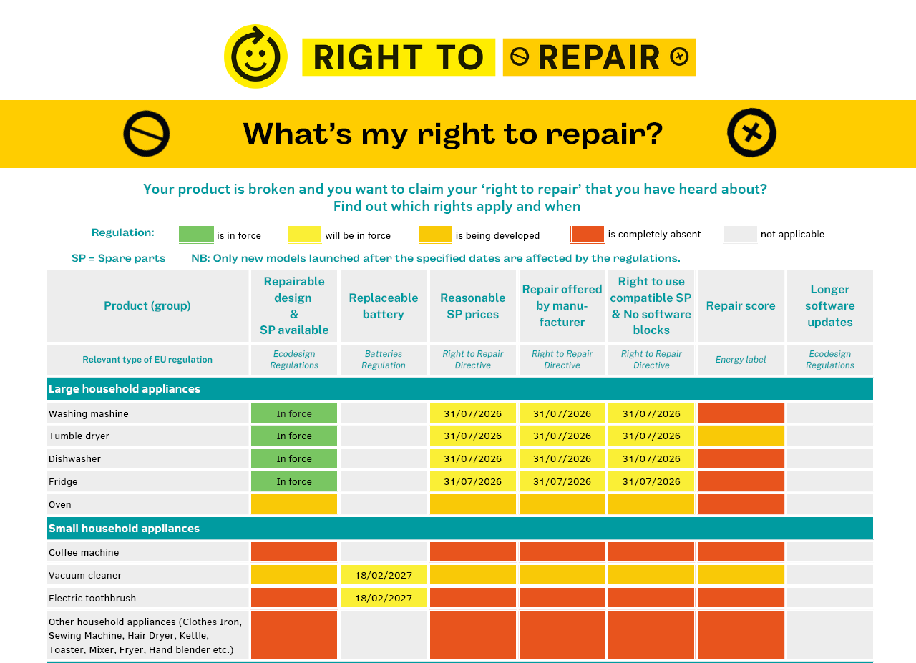

Slide 7
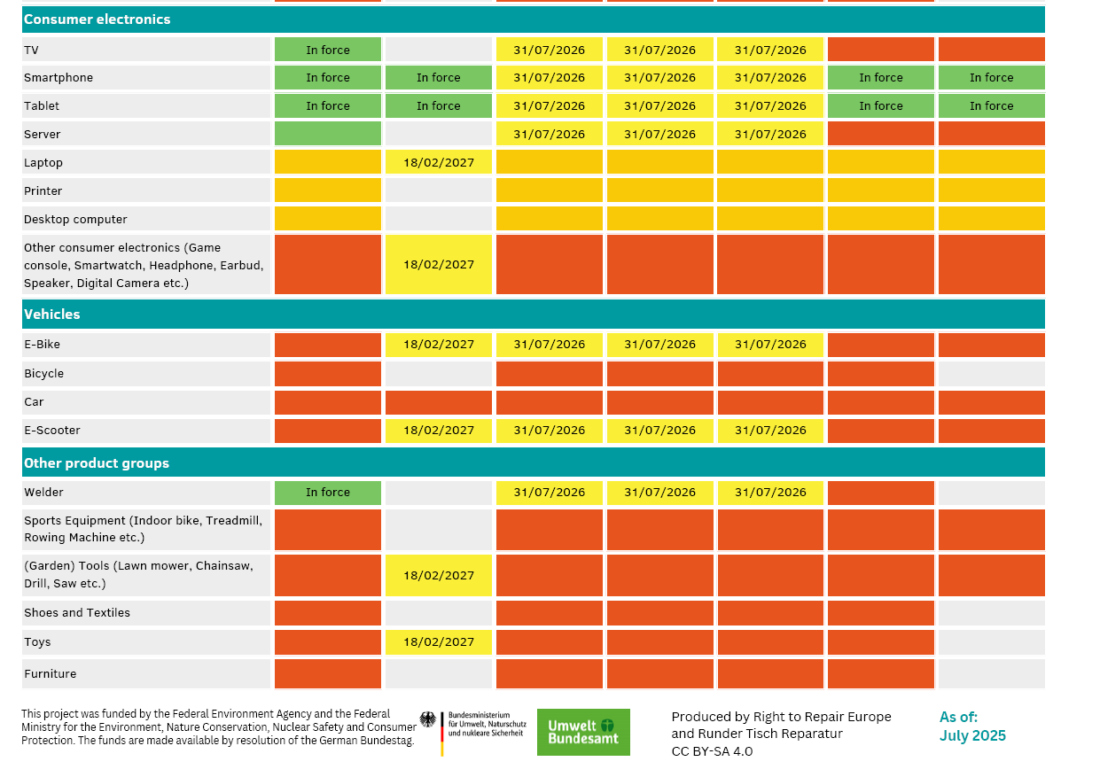

Slide 8
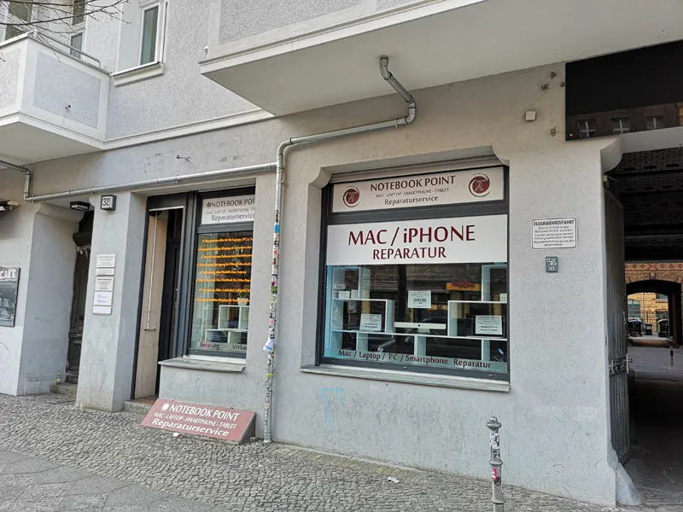
Repairs must become easy and affordable
© Notebook Point – Mac Reparatur Berlin
Repair shops around every corner being able to offer competitive repair prices

Slide 9
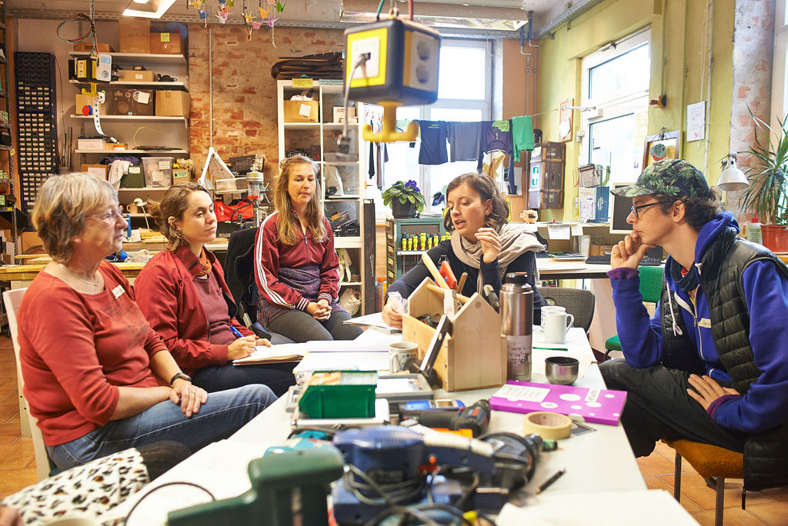
Repairs must become easy and affordable
© Notebook Point – Mac Reparatur Berlin
© Café Kaputt
Repair shops around every corner being able to offer competitive repair prices
Well-known community repair places

Slide 10
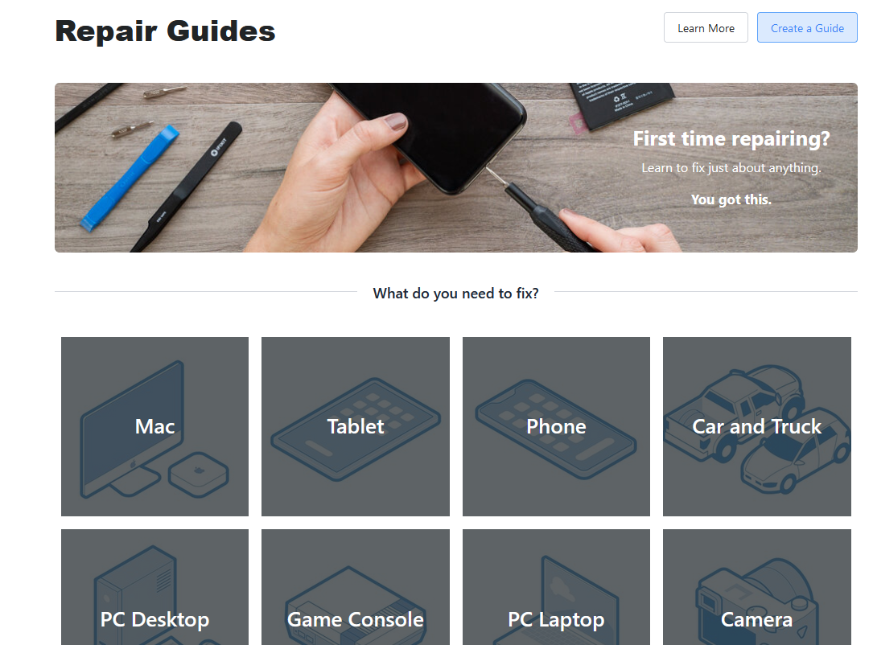
Repairs must become easy and affordable
© Notebook Point – Mac Reparatur Berlin
© IFixit
© Café Kaputt
Repair shops around every corner being able to offer competitive repair prices
Well-known community repair places
Well-known possibilities for DIY repair

Slide 11

The right to repair on city level

Slide 12
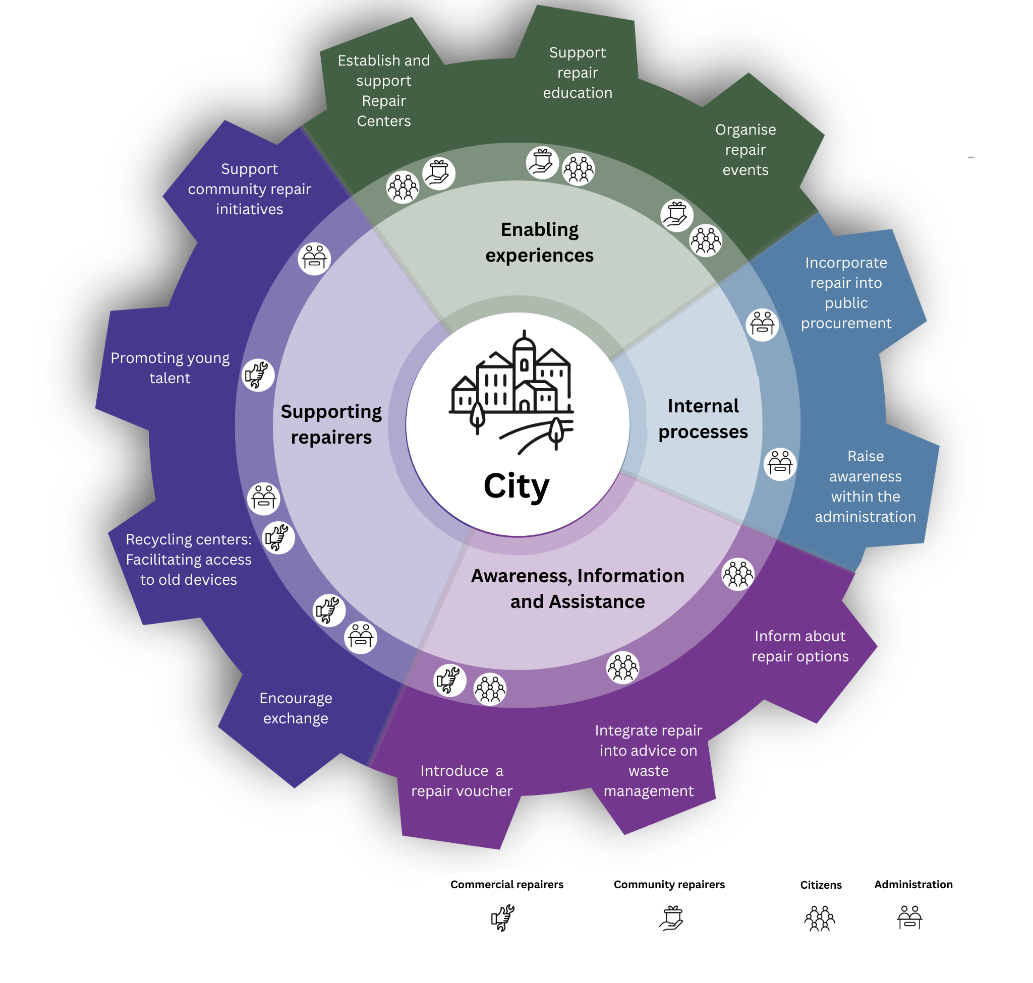
The right to repair on city level

Slide 13
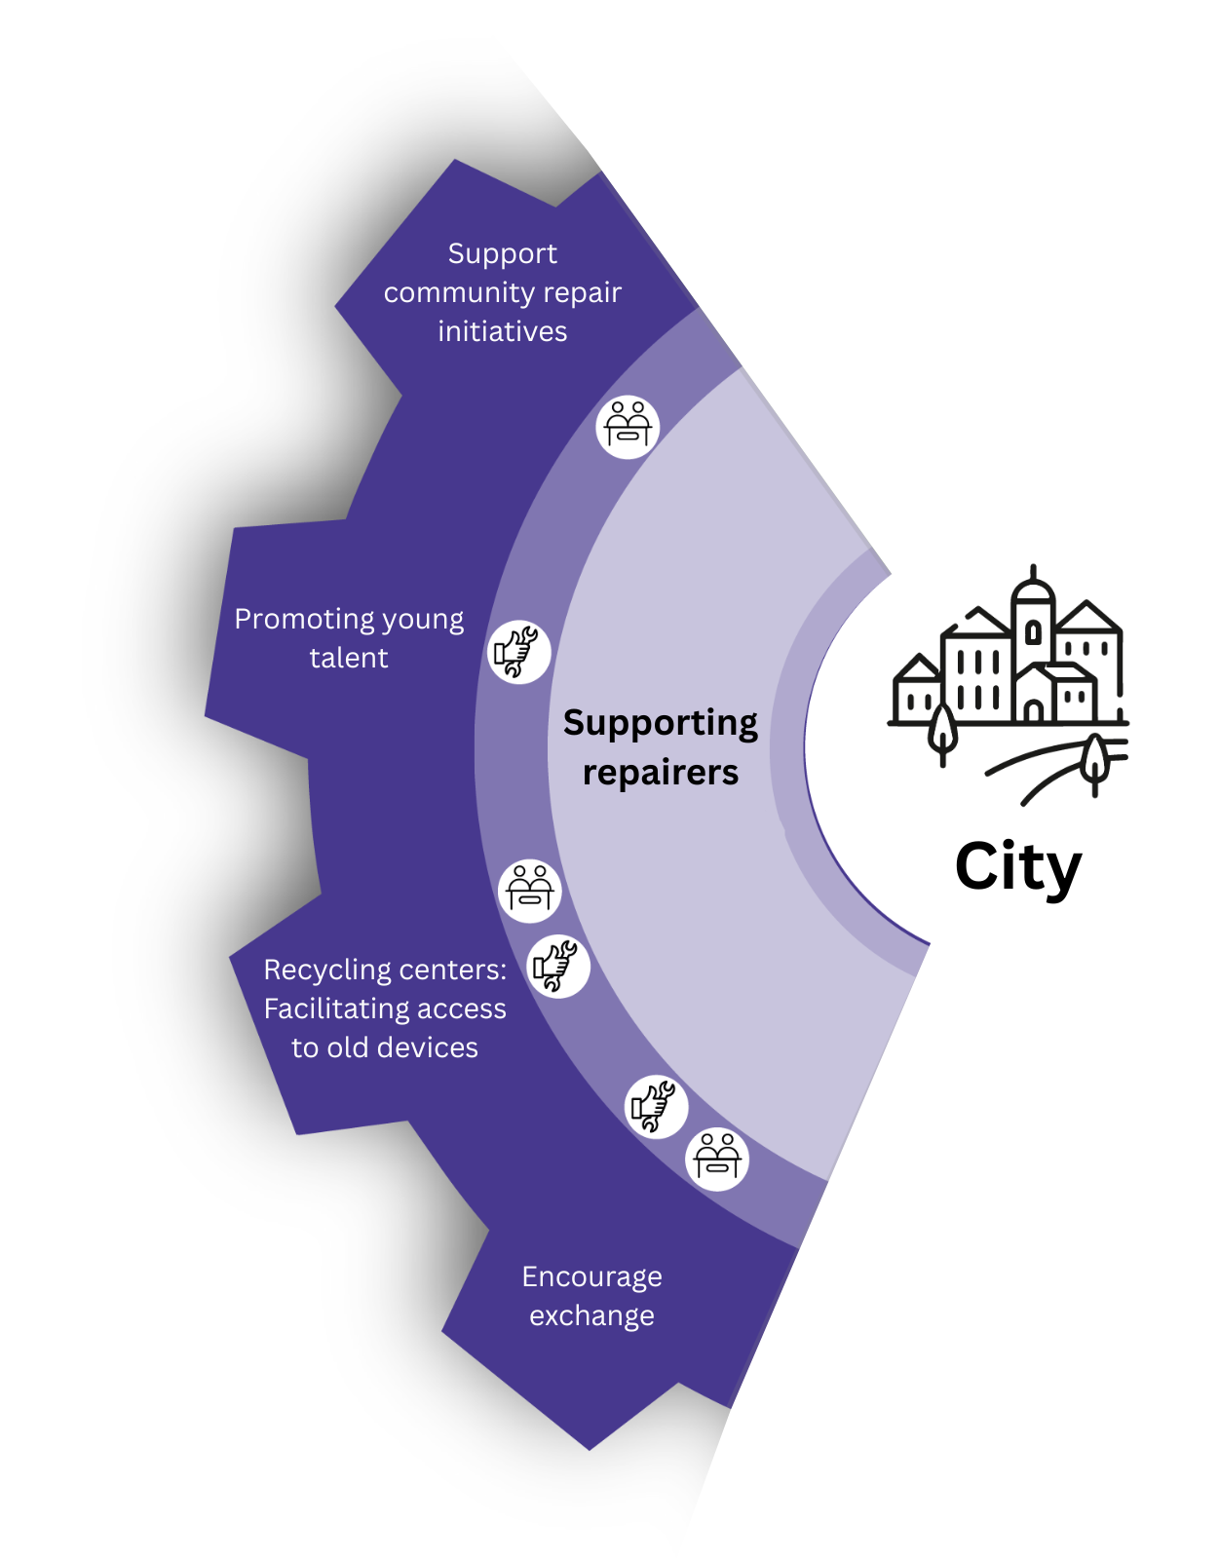
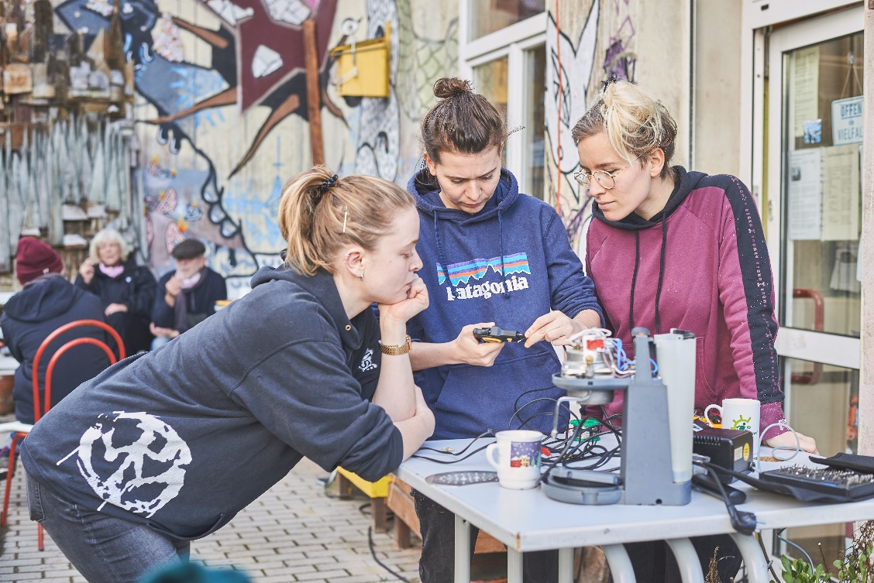
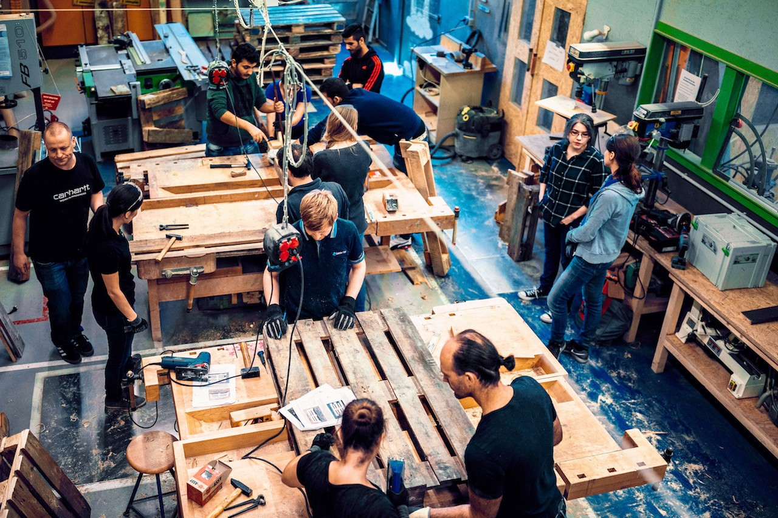
Supporting repairers
© Café kaputt / leben.lernen.leipzig e.V., Lauren McKown
© Hobbyhimmel Stuttgart/ Benjamin Hanus

Slide 14
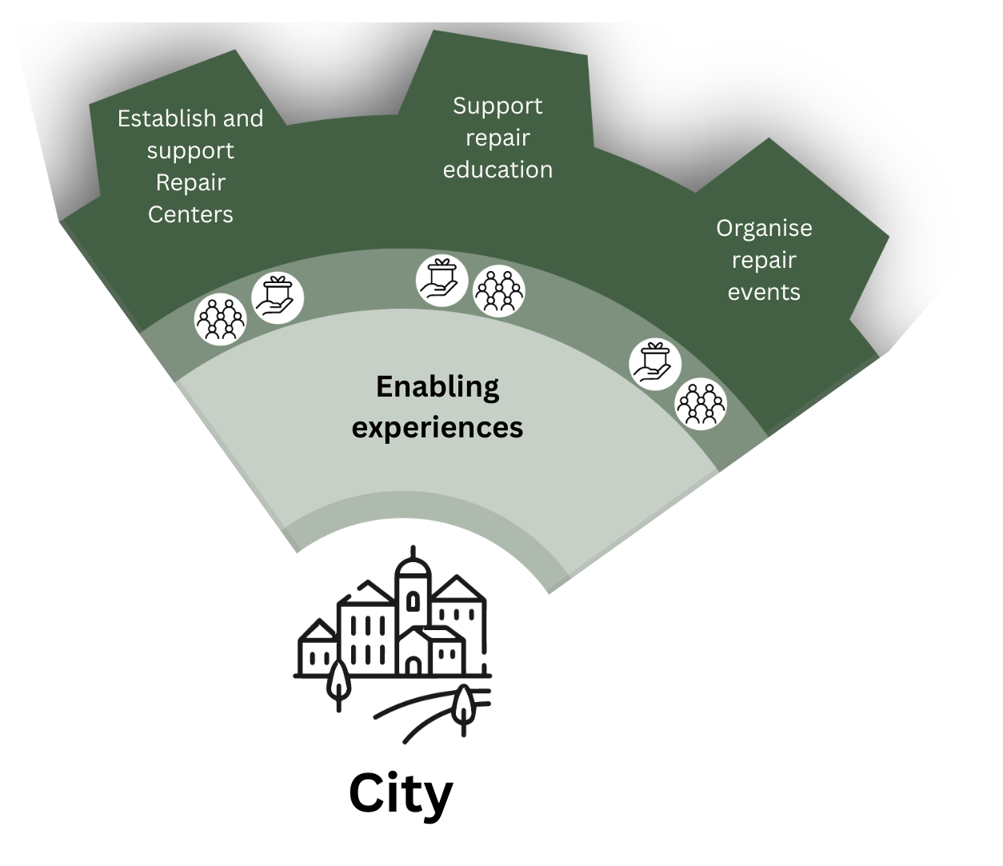
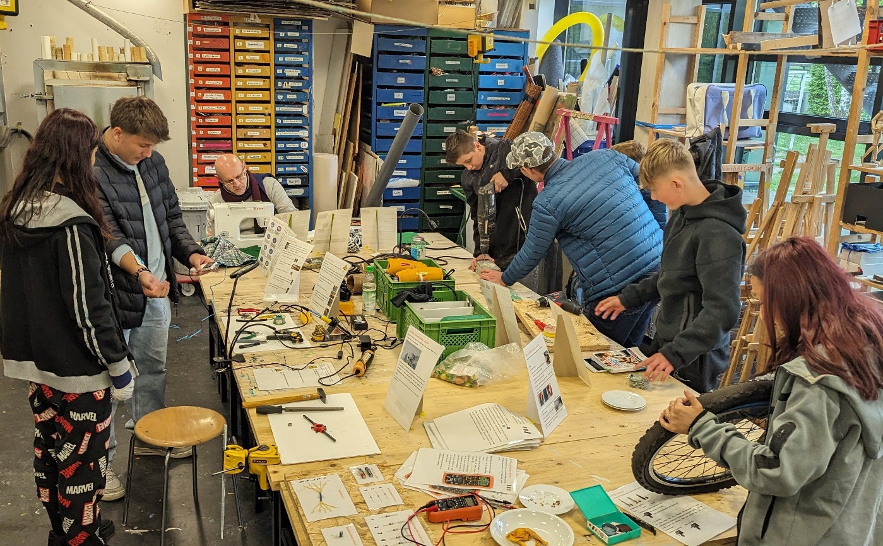
Enabling experiences
© Machsganz

Slide 15
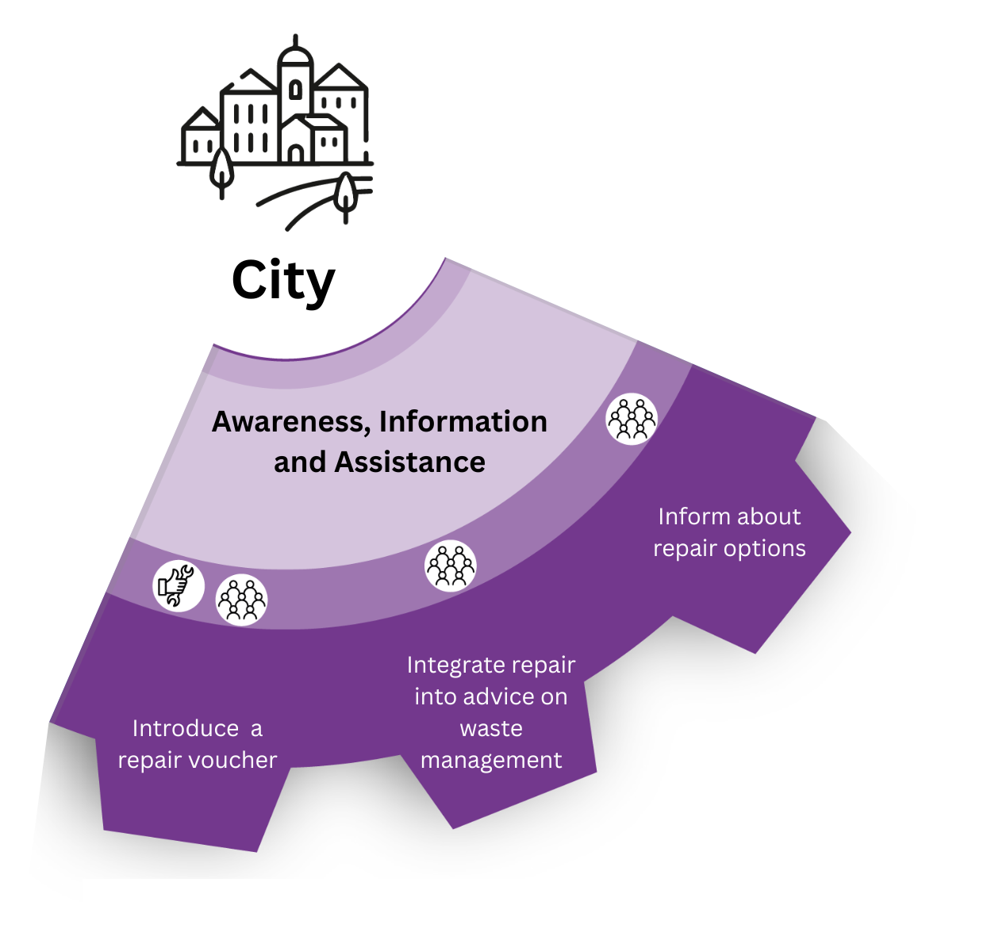
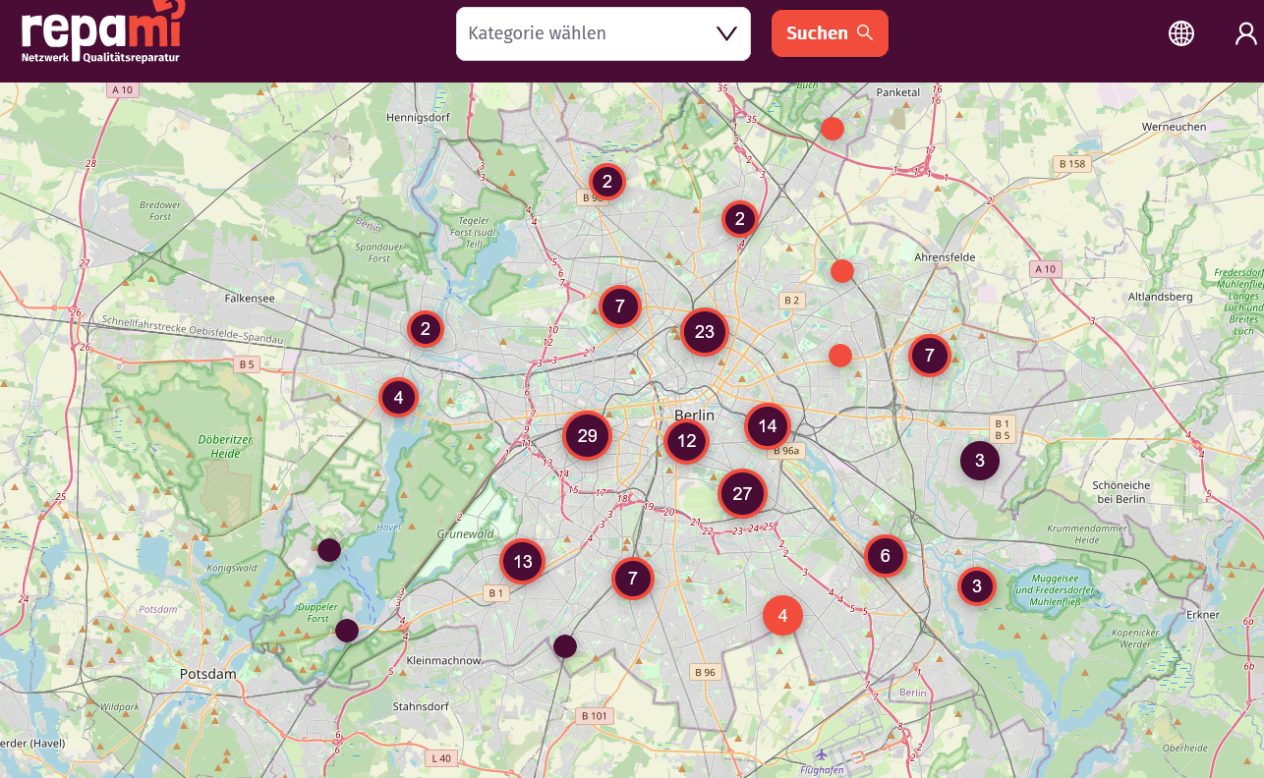
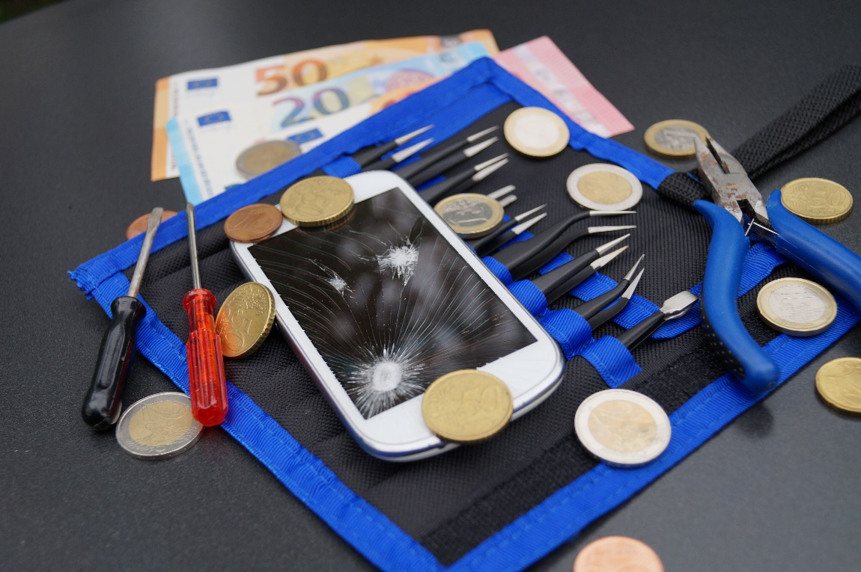
Awareness, Information and Assistance

Slide 16
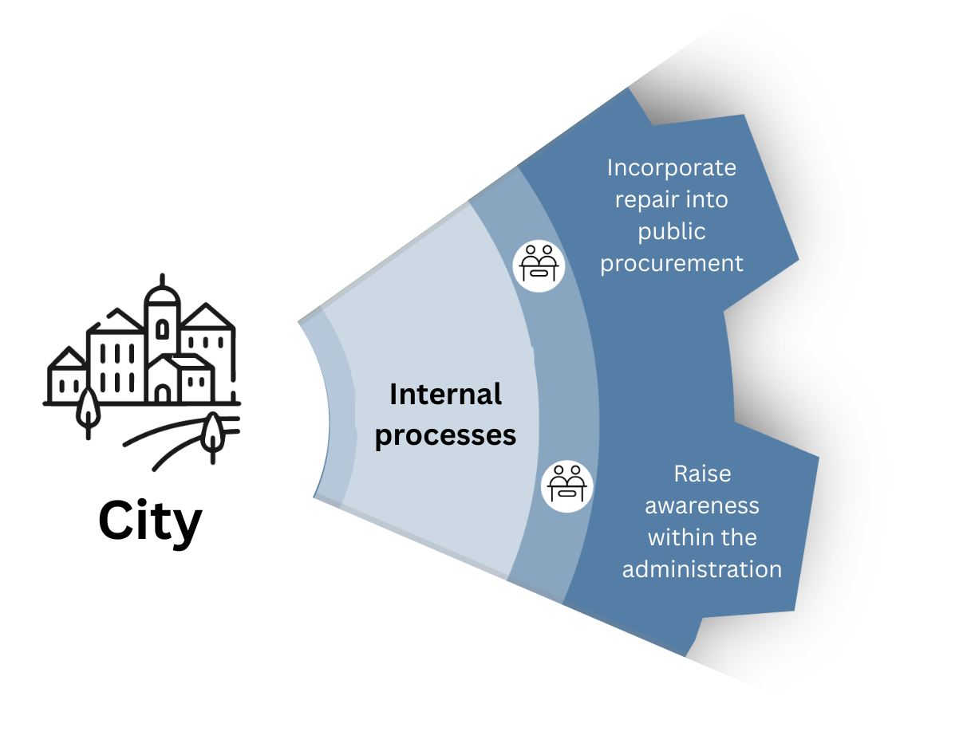
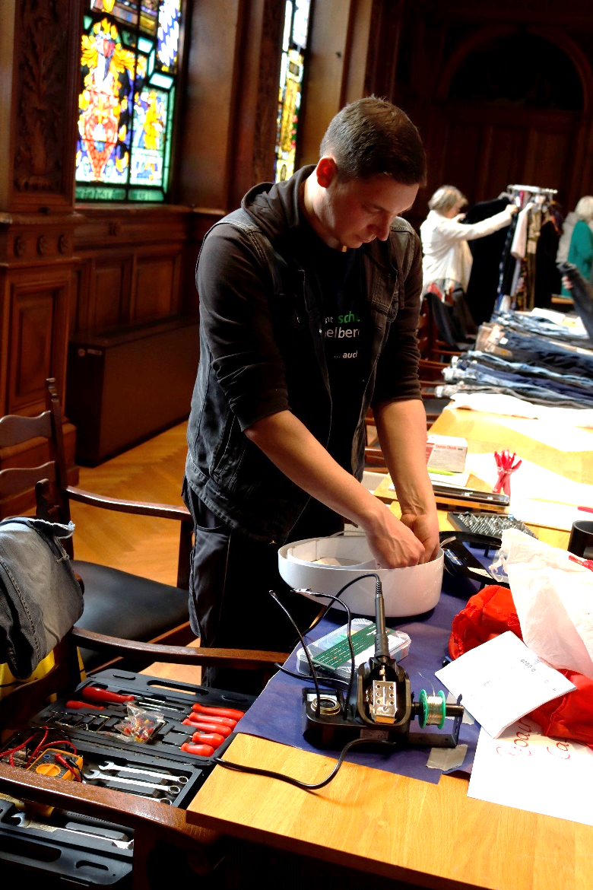
Internal processes
© City of Heidelberg

Slide 17
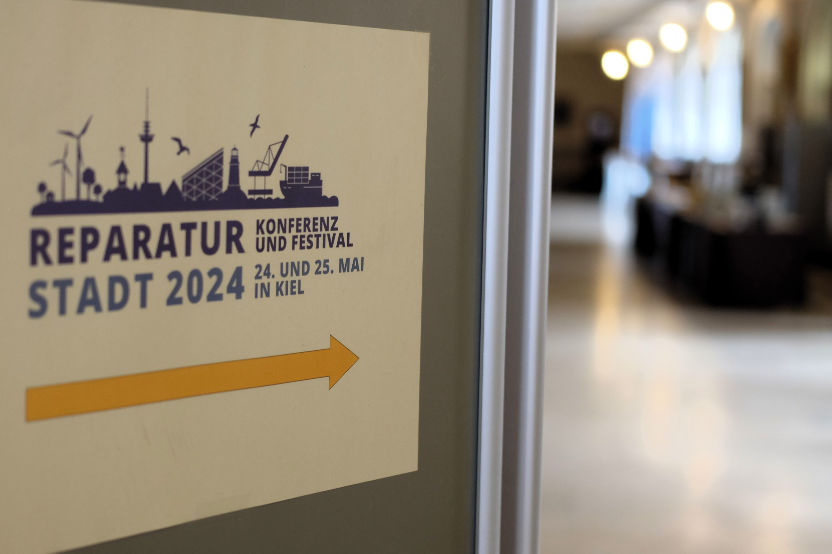
Group task
Which measures are already in place in your city?
2. Which measure(s) would you like to initiate?
Relevant stakeholders
Existing local networks
Funding
Specific first steps

Slide 18
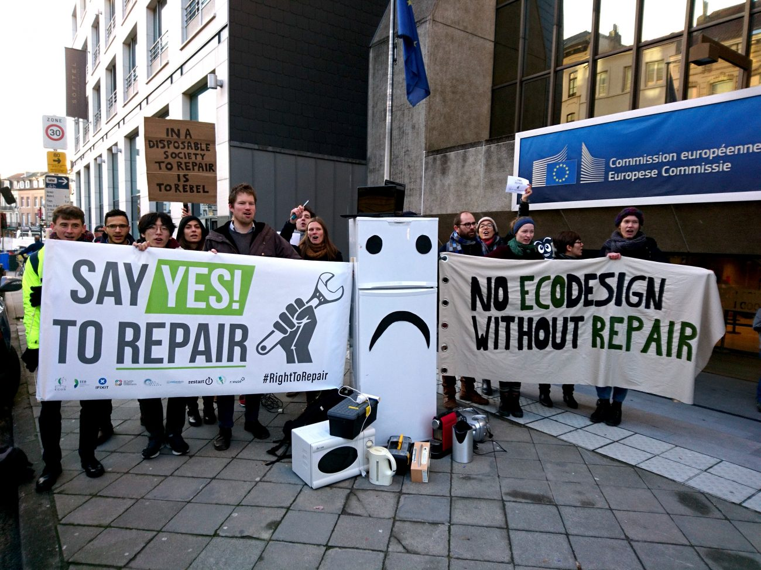
Contact
Katrin Meyer
katrin.meyer@runder-tisch-reparatur.de
Alena Romanova
alena.romanova@runder-tisch-reparatur.de
www.runder-tisch-reparatur.de

