Slide 1











Engaging industrial stakeholders in circular practices: lessons from the REUSE2030 project
Notes:
The partnership: 10 organizations, 9 countries

Slide 2



Identify Solutions
Develop and Test
Adoption
Identify circular economy solutions to reduce waste streams
Digital tools to enable the adoption of circular practices in mechanical companies.
Foster the adoption of circular tools and solutions through networking and capacity building packages

Slide 3
REUSE2030 Strategy & Operational Plans
Deployment of CE solutions and tools
To identify circular economy solutions and instruments to reduce waste streams of identified mechanical companies / SMEs
To foster the adoption of tested circular economy solutions and tools by mechanical companies/SMEs at CE level, through capacity building paths
1
2
3
Digital Circular Inventory and Zero Carbon Tool
To develop and test circular economy digital instruments and tools to be adopted by identified mechanical companies and SMEs
Notes:
Companies/SMEs involvement in the development and testing of tools
The utility of these digital tools is a prerequisite for their large-scale adoption
Comparative mapping and reporting of mechanical companies in 9 European countries.

Slide 4
How can we better connect SMEs, cities and circular solutions?
Notes:
Today we will explore four dimensions of circular transformation: drivers and barriers for SMEs, enabling cities and ecosystems, digital tools, and capacity building for long-term change.

Slide 5
Key insights from REUSE2030
Group discussions
Shared recommendations
Interactive poll

Slide 6
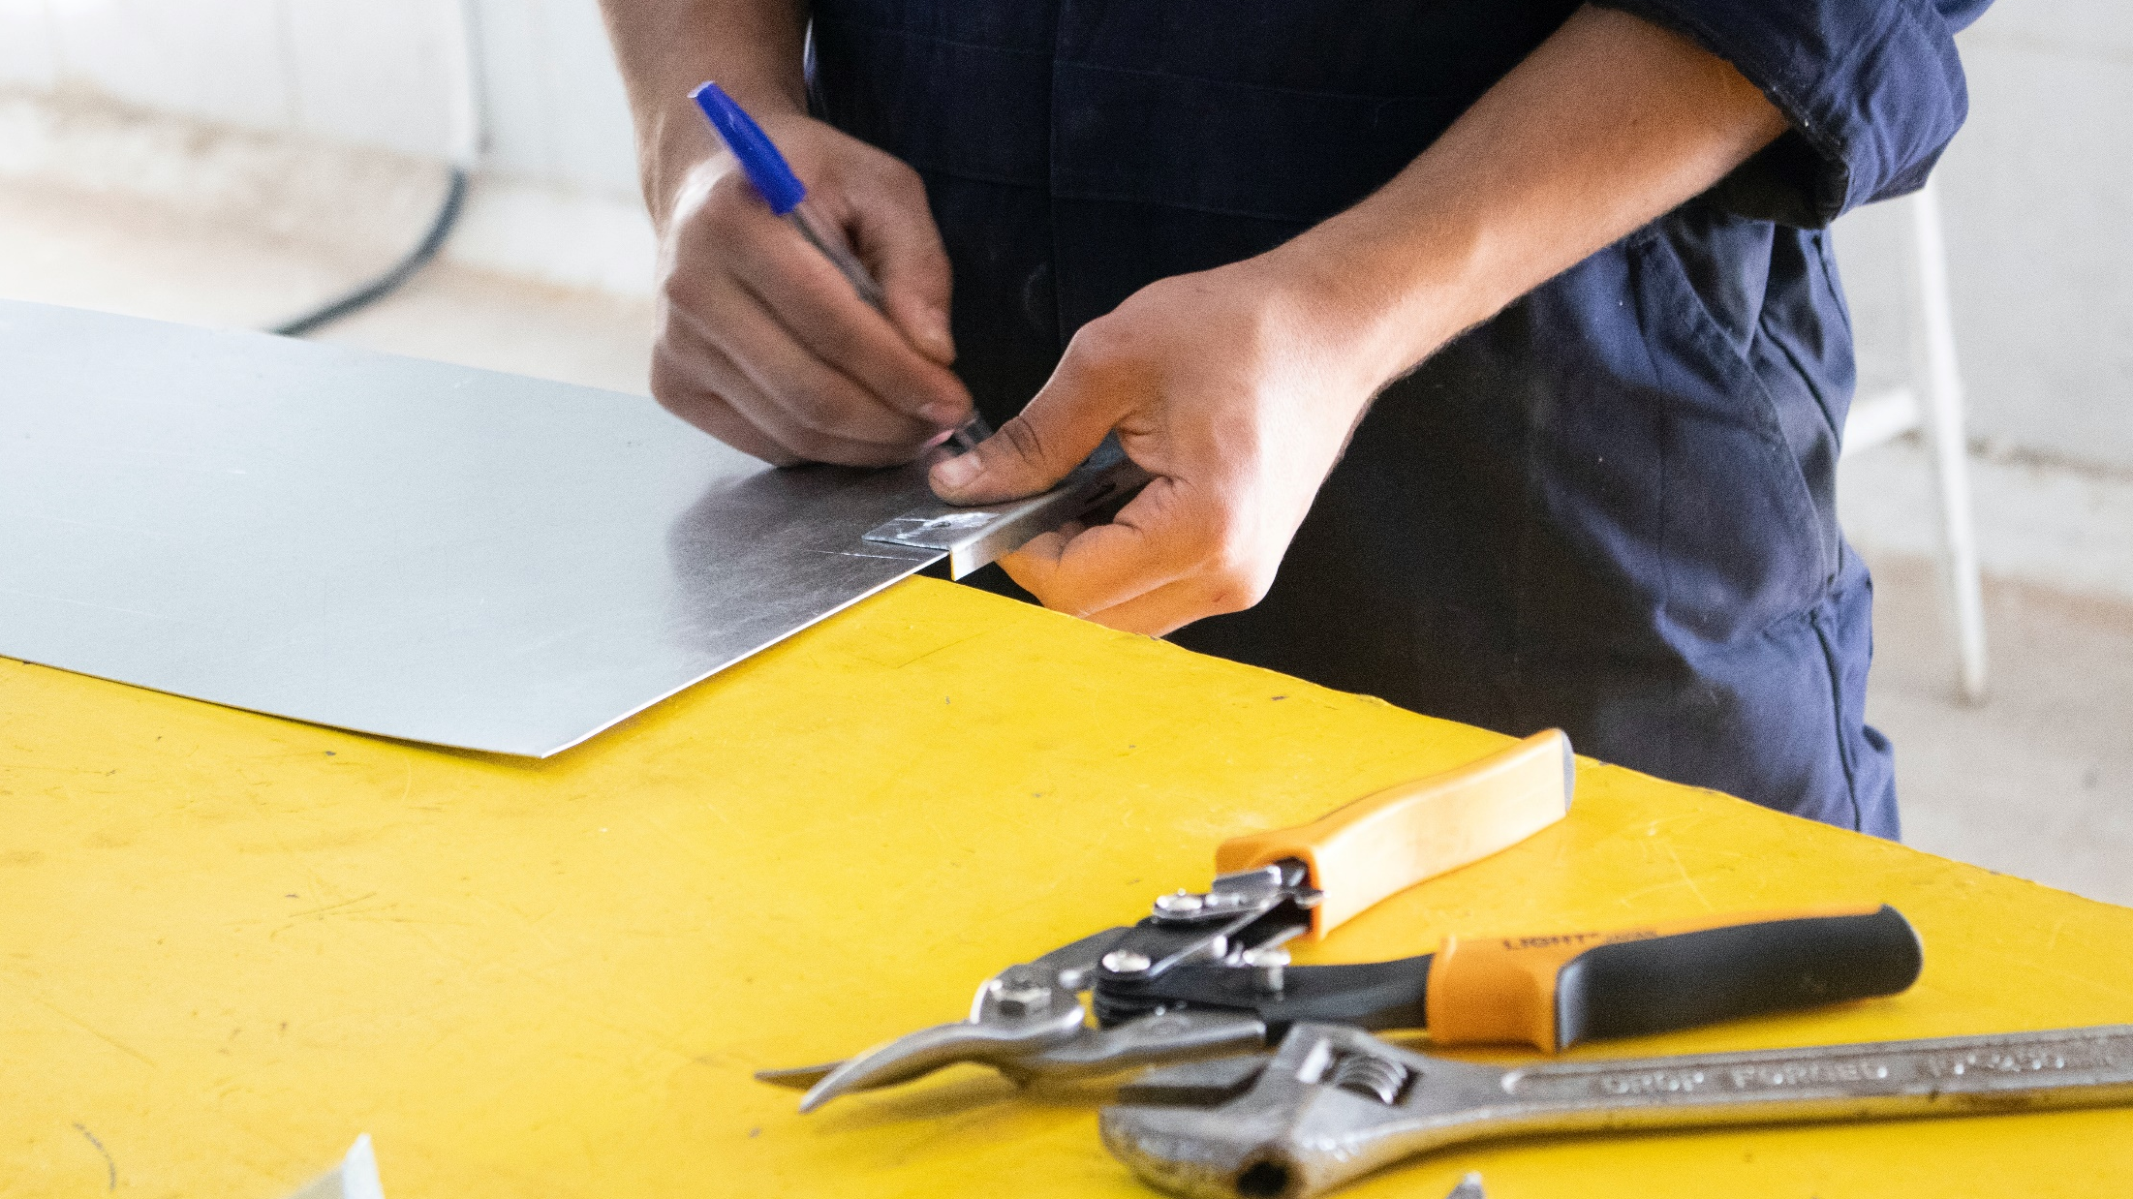
Lessons from engaging SMEs
Notes:
What we learned from REUSE2030

Slide 7
WHAT MAKES SMEs MOVE
Circularity becomes attractive to SMEs when the business case is tangible and short-term
SMEs move in ecosystems: trusted peers and intermediaries are the real gateway to change
Complexity is the enemy: SMEs need solutions that fit into their daily operations, not extra burdens

Slide 8
WHAT INSTITUTIONS CAN DO
Regions and cities are most effective when they act as enablers, not just regulators
Policy works better when it is co-designed with SMEs
Long-term commitment requires institutional continuity and trust-building

Slide 9
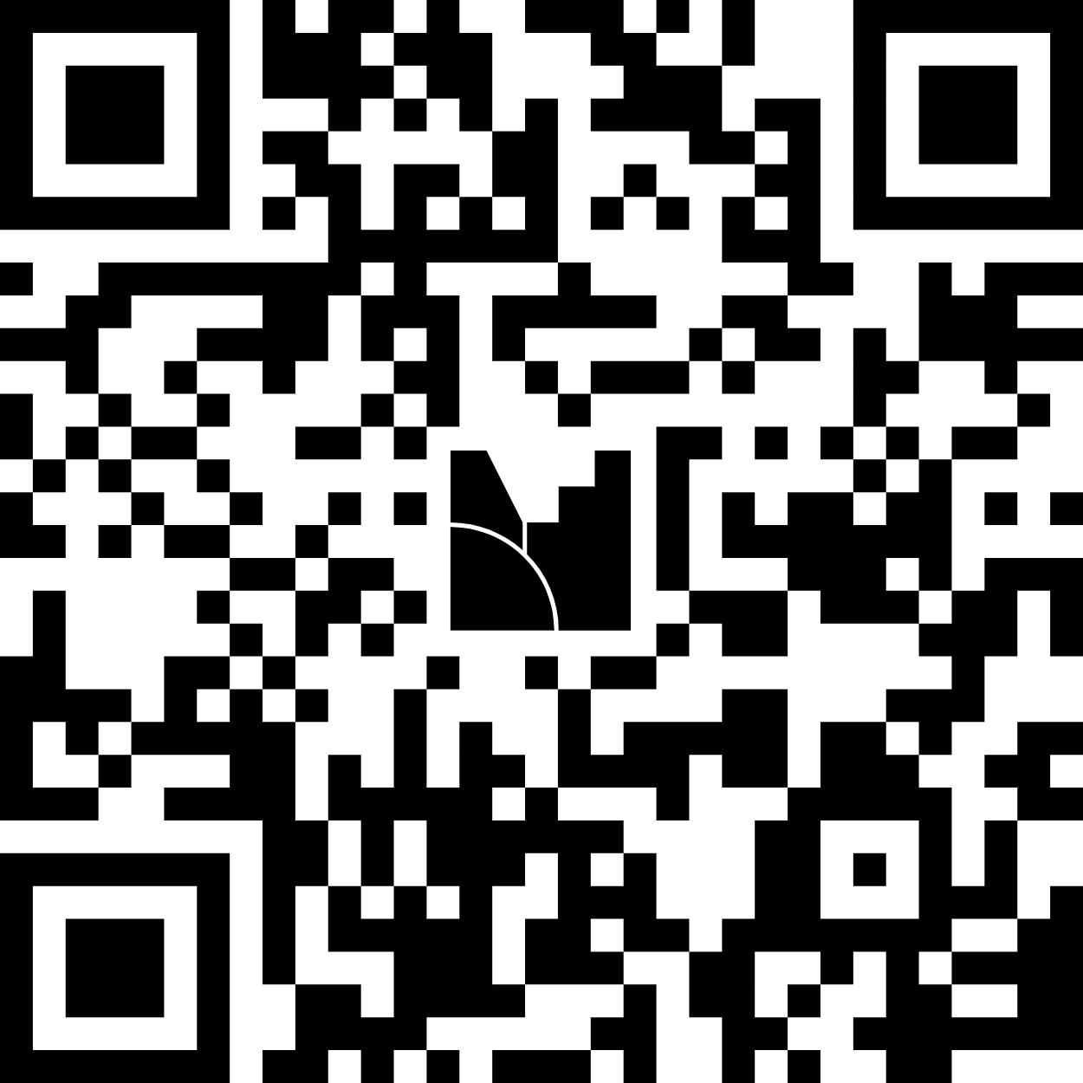
JOIN THE POLL!
or visit mentimeter.com
and insert the code:
2560 9844

Slide 10
Discuss your guiding question and identify:
3 key insights
1 practical recommendation
You have 30 minutes.

Slide 11
KEY INSIGHTS & TAKEAWAYS
or visit mentimeter.com
and insert the code:
2560 9844
Notes:
Word cloud: Circular transition requires
Motivated SMEs
Enabling cities and regions
Practical digital tools
Continuous learning

Slide 12

THANK YOU!
Visit our website and follow our social to get the latest updates:
https://www.interreg-central.eu/projects/reuse2030/
REUSE2030

