Slide 1



The NiCE Knowledge Platform: a Toolkit for Urban Circular Lifestyle Transformers
Mariann Szabó PhD
Budapest University of Technology and Economics, Department of Environmental Economics and Sustainability
NiCE Closing Conference, Dessau-Roßlau, 11-12 March 2026

Slide 2

Agenda
Introduction to the NiCE project & group formation (15 min)
Individual work: Defining top priorities for circular lifestyles in your city or neighbourhood (10 min)
Groupwork: Thematic adaptation analysis of Good Practices (15 min)
Groupwork: Adaptation analysis of resources and pilot documentation (15 min)
Conclusions & Wrap-up (20 min)

Slide 3
About the project
European city centres used to be busy resource-intensive centres of consumption, but due to the Corona pandemic and a shift towards online trade, numerous shops had to close, and the supply chains were interrupted. Alternative and sustainable consumption models leading to more circularity and sufficiency increase do exist, but due to the current framework conditions, these models usually only remain in their niche.
NiCE project’s challenges
transformation of central places in cities that make it easy for their inhabitants to implement sustainable lifestyle in accordance with principles of circular economy
(re)animate centres in a more circular way
Duration: May 2023 – April 2026 (3 years)

Slide 4

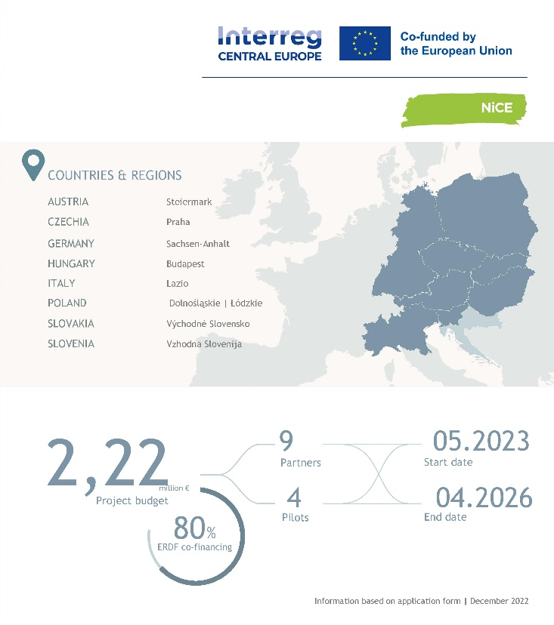
Project Partners
The German Environmental Agency (DE), lead partner
ENVIROS, an environmental protection related consulting company (CZ)
StadtLABOR, a lab for sustainable innovation (AT)
Scientific Research Centre Bistra Ptuj, a research and development centre (SI)
Italian National Agency for New Technologies, Energy and Sustainable Economic Development (IT)
Research and Innovation Centre Pro-Akademia (PL)
Budapest University of Technology and Economics (HU)
Creative Industry Košice, n.o., a creative agency (SK)
Municipality of Brzeg Dolny (PL)

Slide 5
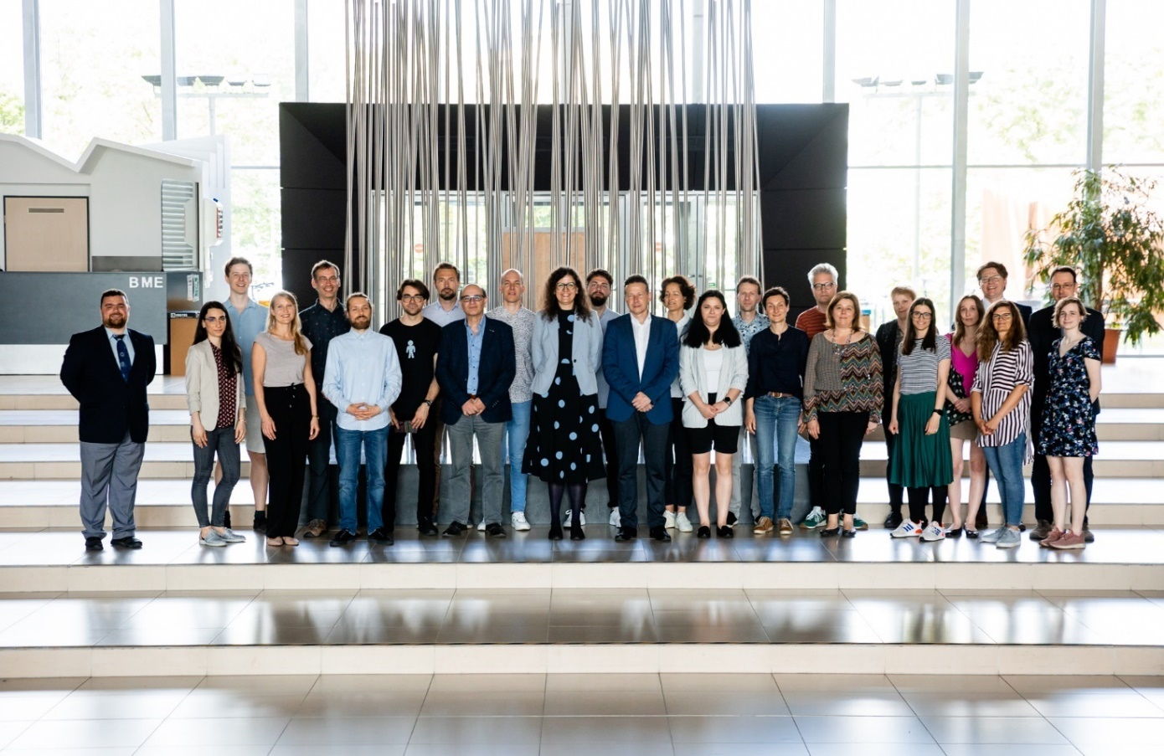
Source: Geberle B. (BME)

Slide 6

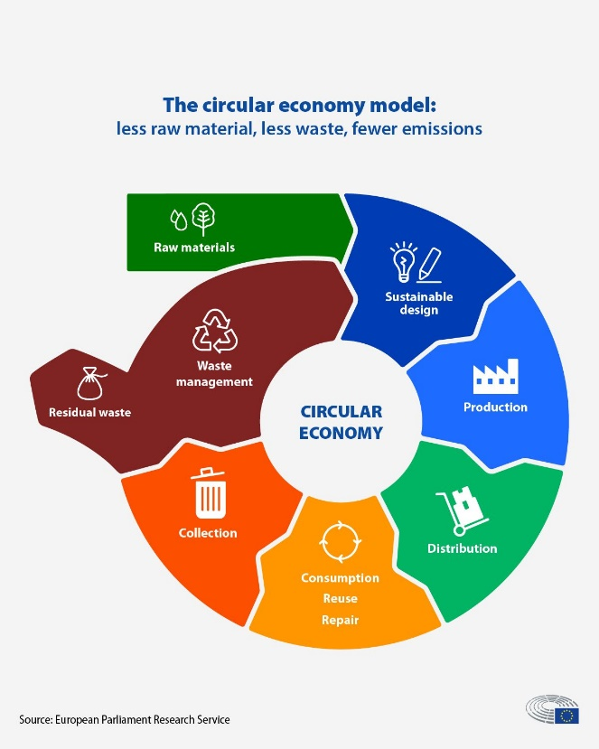
Circular economy citizenship – more than recycling

Slide 7
Options for closing resource loops with circular lifestyles
Options for closing resource loops with circular lifestyles
Shortest Loops:
R0-R3
(Refuse, Reduce, Resell/reuse)
Medium Long Loops: R4-6 (Refurbish, Remanufacture, Repurpose)
Long Loops:
R7 (Recycling)
Value Retention Options in Circular Economy by Reike, Vermeulen & Witjes, 2018
Portfolio of circular lifestyles enablers in urban areas
Circular economy citizenship - decision of inhabitants
Szabó, M., Gimkiewicz, J., Cappellaro, F. et al. Transition to circular economy of urban areas and communities with special attention to lifestyles. Discov Sustain 5, 482 (2024). https://doi.org/10.1007/s43621-024-00726-0

Slide 8
Essence of the NiCE project
Political measures, action plans, development plans, strategies and programmes
NiCE Countries (DE, CZ, AT, SI, IT, PL, HU, SK)
Cities
Sustainable consumption patterns and supporting business models
Cities (Bologna and Porto-Saragozza district in Italy, Brzeg Dolny in Poland, Budapest and Újbuda district in Hungary, City of Jihlava in Czechia, Graz in Austria, Košice in Slovakia, Ptuj in Slovenia and Würzburg in Germany)
International & EU level
Interviews
Needs’ assessment (focus group discussions, interviews, co-creative workshops, Living Labs)
Desk research
Secondary research (frameworks for the promotion of circular economy, circular roadmaps)
Circular lifestyle monitor tool for cities
Longlist of transnational good examples – Virtual Exhibition
Strategy framework to enable circular lifestyles in cities
Tandem 1 – Initiate the reuse of spaces in city centres (StadtLABOR + CIKE)
Tandem 2 - Multifunctional resource centres
(ZRS Bistra Ptuj + Brzeg Dolny)
Tandem 3 - Sustainable e-commerce in city centres
(UBA + ENVIROS)
Tandem 4 - Activation of users for circular lifestyles
(ENEA + BME)
1. Solution box (four transferable solutions based on the pilot implementation experiences)
2. Documentation of pilot implementation (blogs, videos)
Circular Lifestyle Knowledge Platform: The central legacy of the NiCE project, integrating all key results

Slide 9
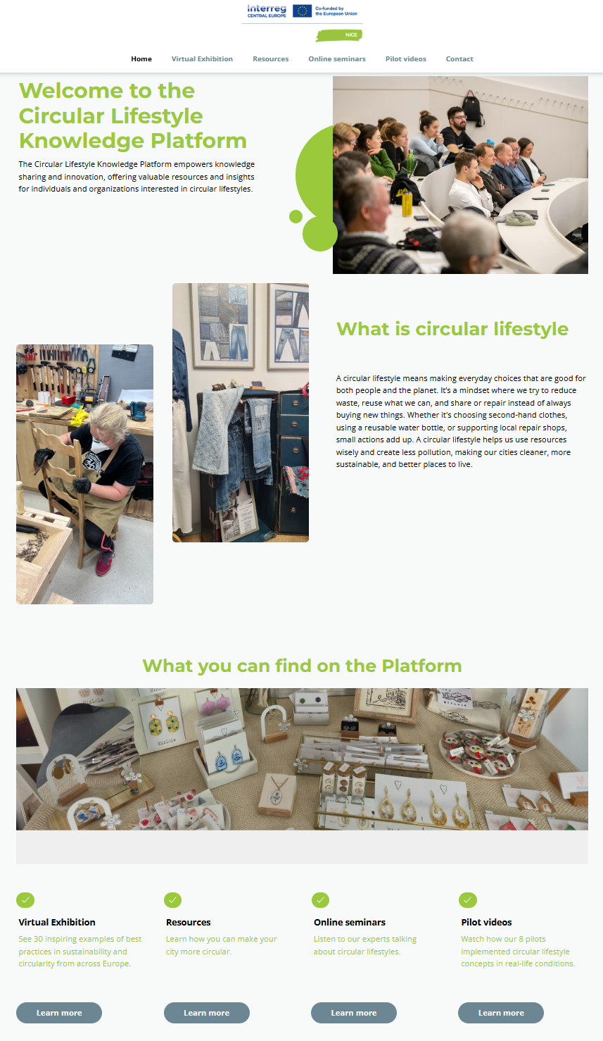
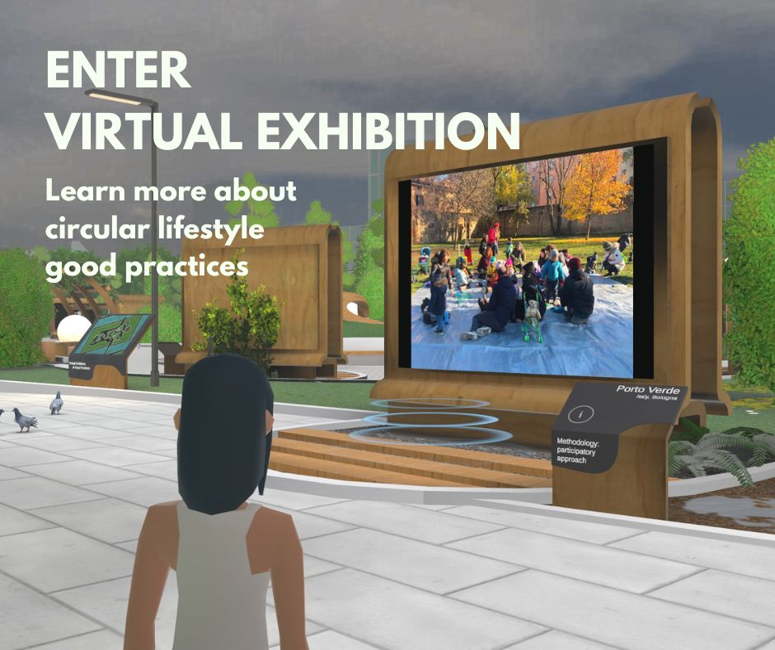
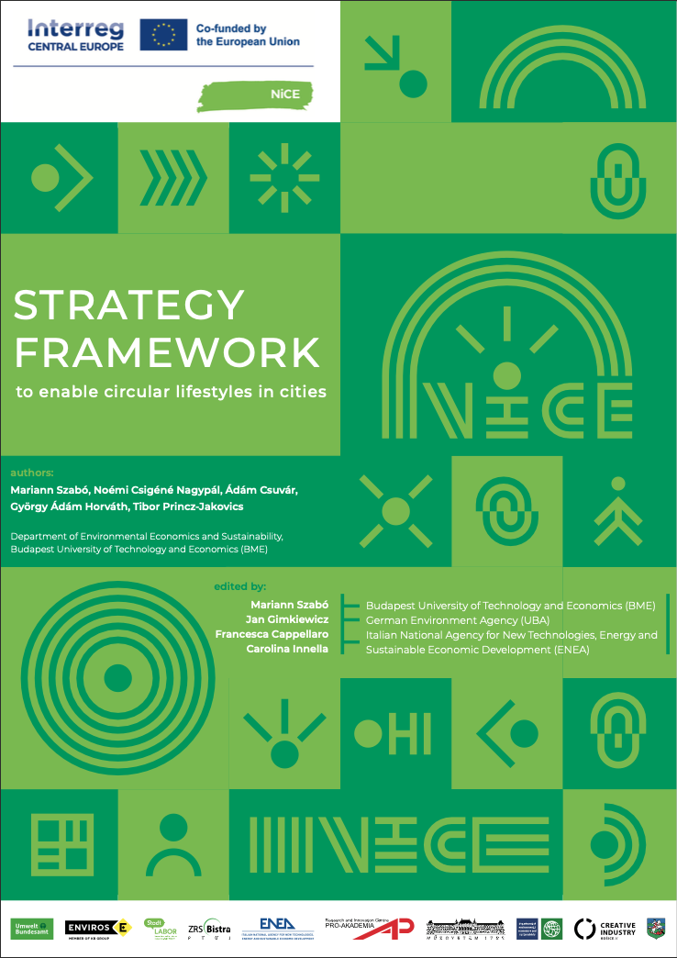
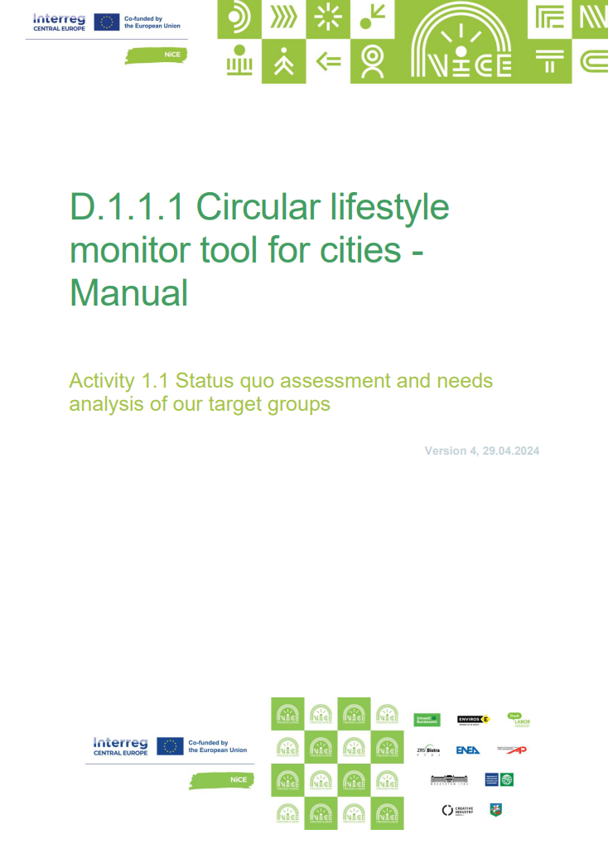
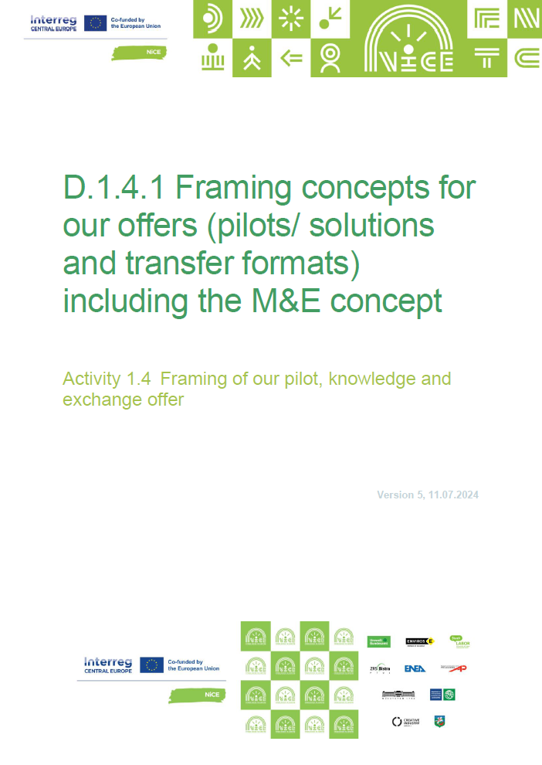
Resources: NiCE Solution Box
based on the pilot experiences
Methodology Kit on stakeholders' engagement in circular lifestyles
Guide: How to build, run and sustain a multifunctional resource centre
How to link sustainable e-commerce with city centres
Circular Water Kit addressing water re-use and water saving in cities
Resources: Circular lifestyle tools for cities, authorities
Online seminars (videos)
Big Points for Sustainable Consumption and Circular Lifestyles
The role of urban, university and school living labs in promoting circularity
Bringing circularity closer to people – the experience from Graz and Warsaw
Circular Lifestyles, E-commerce and city centres, are they compatible?
Urban Regeneration with Circular Economy Principles
Building community around multifunctional resource centres
Opportunities and challenges for circular water management
https://circularlifestyle.eu/
Austria - Future House S in Graz
Czechia - Multifunctional resource centre SILO Jihlava
Germany - Linking e-commerce and circular lifestyle offers in city centre in Würzburg
Hungary - Co-creation for more circular cities at the Budapest University of Technology and Economics
Italy - Testing circular water management solutions in Bologna
Poland - Multicentrum Zero Waste in Brzeg Dolny
Slovakia - Reuse centre Košice
Slovenia - Pop-up store in Ptuj
Article: Transition to circular economy of urban areas and communities with special attention to lifestyles
Resources: Educational materials (soon)
Card Game: Climate Scale
Circle City – a cooperative board game about sustainable life in the city
Pub Quiz and Educational Game
Young researchers approach for circular economy
Quiz on saving water
Upcycling workshop guides: sewing a pillow from textile scraps
Workshop for student groups on circular lifestyles
Best Practice Examples – Virtual Exhibition
Plant-based circular cookbook

Slide 10
Group formation
Group 1 | Group 2 | Group 3 | Group 4
Urban Regeneration & Resource Management | Community Creation & Sustainable Consumption | Innovative Solutions | Green Spaces & Systems Thinking
Nataša Mršek (Bistra) Attila Buzási (BME) Laila Gao (City of Heidelberg) Ulrike Haase (TU Dresden) Carmen Richerzhagen (DLR) Matúš Binc (K13) | Alexandra Matiova (CIKE) Fruzsina Bozsoki (BME) Marga Molina (Blue!) Vanessa Heinrich (TU Munich) Anna Eikenberg (City of Dresden) Holger Hoff (University of Graz) | Lucia Koukolová (CIKE) Gábor Ballabás (BME) Yi Hua Feng (TU Munich) Karl Eckert (UBA) Ivana Maleš (Inst. for circular economy) Matthias Pieper (Zukunftshaus) | Lisa Frien-Kossolobow (UBA) Sude Berfin Türker (TU Munich) Miriam Dross (UBA) Michelle Schneider (UBA) Conrad Dorer (Uni Magdeburg) Simona Šoltésová (CIKE)

Slide 11
Agenda
Introduction to the NiCE project & group formation (15 min)
Individual work: Defining top priorities for circular lifestyles in your city or neighbourhood (10 min)
Groupwork: Thematic adaptation analysis of Good Practices (15 min)
Groupwork: Adaptation analysis of resources and pilot documentation (15 min)
Conclusions & Wrap-up (20 min)

Slide 12
mariann.szabo@gtk.bme.hu
Contact information
Circular Lifestyle Knowledge Platform
https://circularlifestyle.eu/
From Niche to Centre - City Centres as Places of Circular Lifestyles
https://www.interreg-central.eu/projects/nice/?tab=home
LinkedIn: https://www.linkedin.com/company/niceproject/posts/?feedView=all

Slide 13
