Slide 1
Why cooperation is central for circular cities
Final Conference NiCE Dessau-Roßlau | 12/03/2026
Interreg CENTRAL EUROPE | Joint Secretariat Gregorio Vichi

Slide 2



Building Solidarity
Our projects connect regions and people to address shared challenges.
Cooperation is central for taking forward Europe’s transformation
and strengthening its cohesion
Delivering change
Our projects test innovative solutions in real-life settings to drive sustainable growth and support the twin transitions.
Achieving synergies
Our projects enable regions and cities to pool resources and knowledge for solutions with broader impact.

Slide 3
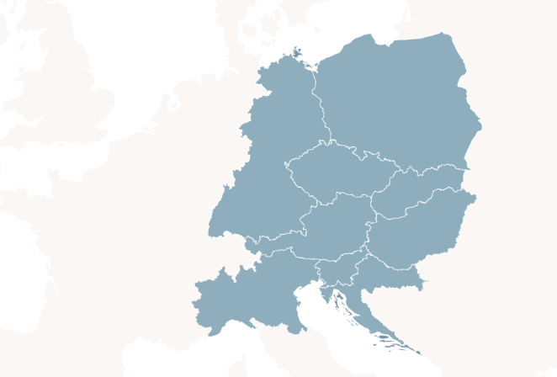
How does NiCE fit into this bigger picture?

Slide 4
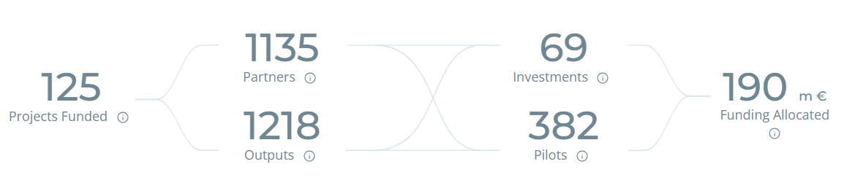

Slide 5
Why is NiCE one of our funded projects?
Balanced and fitting partnership
9 partners cooperating across 8 countries
Relevant and timely topic
Revitalising city centres promoting circular lifestyles
Promising pilots and outputs
4 solutions for circular lifestyles and sustainable development in cities pioneered jointly in 8 pilot sites

Slide 6
How to take
NiCE‘s cooperation results forward?

Slide 7
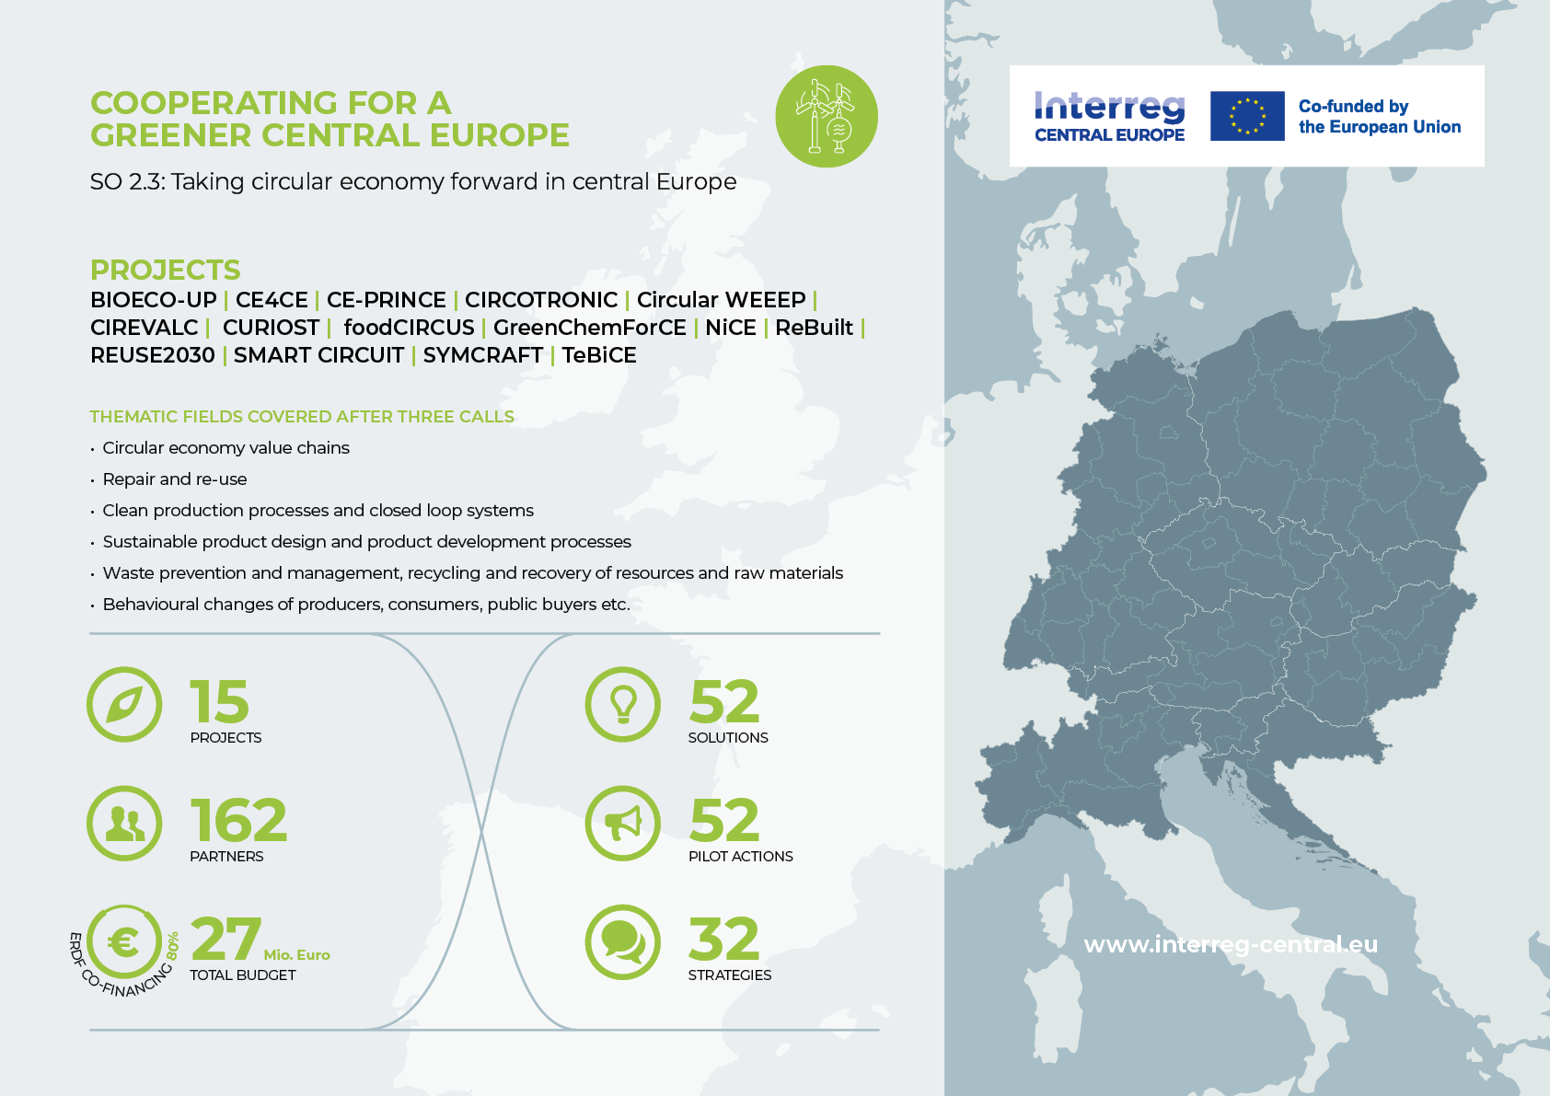

Slide 8

TAKING CIRCULAR ECONOMY FORWARD (SO 2.3)
Behavioural changes of producers, consumers, public buyers etc.
Sustainable product design and product development processes
Waste prevention and management, recycling and recovery of resources and raw materials
Clean production processes and closed loop systems
Bioeco-up | GreenChe﻿mForCE
CURIOST | Smart Circuit
foodCIRCUS | SYMCRAFT
CE4CE | GreenChemForCE |
TeBiCE | Rebuilt
CE-PRINCE | NICE
Circular WEEP | CIREVALC |
foodCIRCUS | REUSE2030
CURIOST | REUSE2030
CIRCOTRONIC | SYMC﻿RAFT
Circular economy value chains
Repair and reuse
Related projects from other SOs
CE4CE | CIRCOTRONIC | CIREVALC | Rebuilt | Smart Circuit| TeBiCE
Bioeco-up | CE- PRINCE
Circular WEEEP
NICE
More than a Village (SO 1.1.)
D4PACK (SO 1.1.)
CarbonFarming (SO 2.1)
CREDIT4CE (SO 1.1)
Bold | Primary contributions to the IP thematic field
italics | Secondary contributions to the IP thematic field

Slide 9

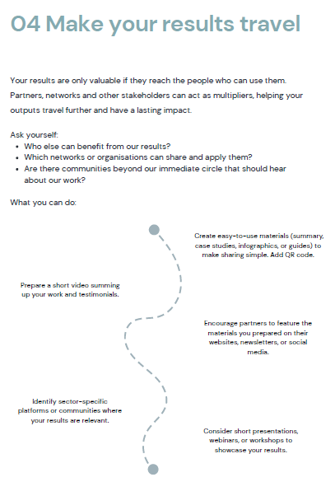
Strengthen the sustainability of your results

Slide 10
How we are taking cooperation forward in central Europe

Slide 11
What’s ahead in 2026
Since January 2026
25 projects are starting their activities for peripheral and lagging areas since January
February 2026
The programming of Interreg CENTRAL EUROPE 2028-34 kicks off with a first meeting of our Member States
May 2026
We will select new capitalisation projects in May and they will kick-off in autumn
Summer 2026
Our partner involvement measures for the new programme will launch – Share your territorial challenges and needs with us

Slide 12

Gregorio Vichi Joint Secretariat
Interreg CENTRAL EUROPE Programme
www.interreg-central.eu
vichi@interreg-central.eu
+43 1 8908088-2416
Facebook.com/InterregCE
Linkedin.com/company/interregce
Youtube.com/c/interregcentraleurope
Instagram.com/interregce

