Slide 1

Addressing barriers & capacity gaps to strengthen social outcomes
Views and opinions expressed are those of the author(s) only and do not necessarily reflect those of the European Union or REA. Neither the EU nor the granting authority can be held responsible for them.

Slide 2



Nele Kelchtermans
R&D Sustainability & circularity assessment
Wim Van Opstal
Research Team Leader Circular Business & Society
VITO – Flemish Institute for Technological Research

Slide 3
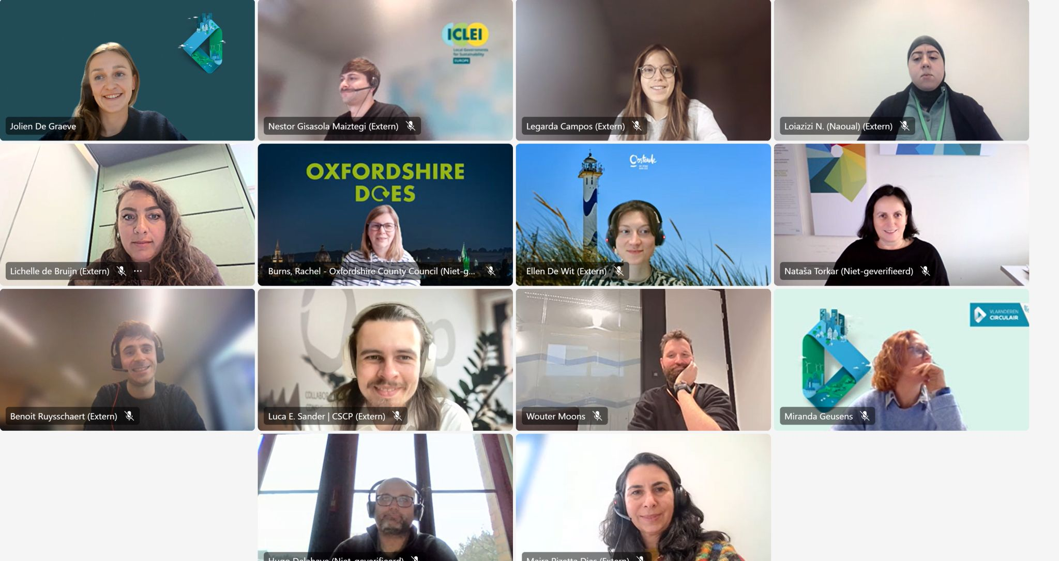
Circular Cities & Regions Initiative - CCRI
By: EC - DG Research & Innovation - Circular Economy Action Plan 2020
Aim: support cities, regions & territorial clusters in accelerating the transition to a circular, competitive and climate-neutral economy
Approach: systemic, place-based and implementation-oriented
Communities of Practice: platforms for exchange, peer-learning, networking – more than 80 participants!

Slide 4
Addressing barriers & capacity gaps to strengthen social outcomes

Slide 5
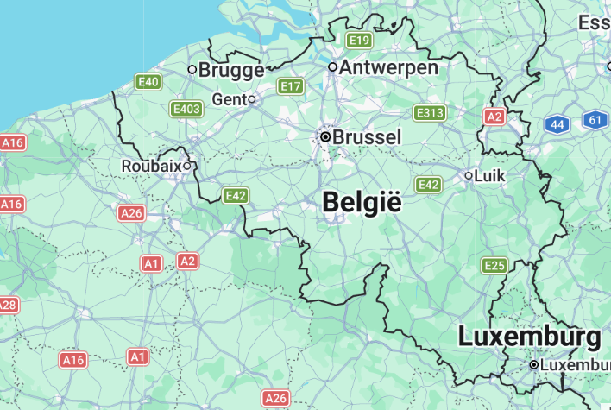
CCRI Testimonies
Hasselt, Belgium, 90,000 inhabitants
Roubaix, France, 99,000 inhabitants
Photo credits: www.recore.be

Slide 6

Hasselt
Photo credits: wonderful.design

Slide 7

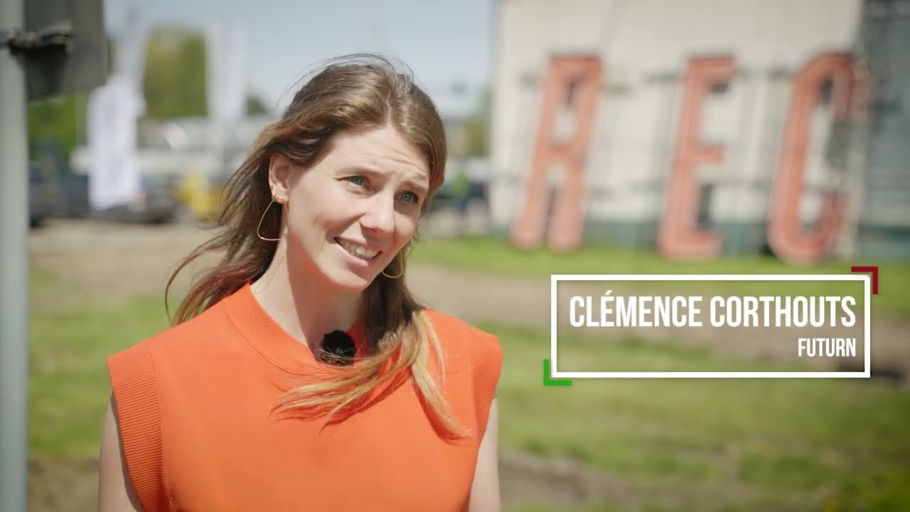
Hasselt
“We are aware that we bought an iconic site in Hasselt, which we have to handle with care. You can only give this site a new purpose once”
Photo credits: www.recore.be

Slide 8

Photo credits: Boumediene Belbachir for De Standaard

Slide 9

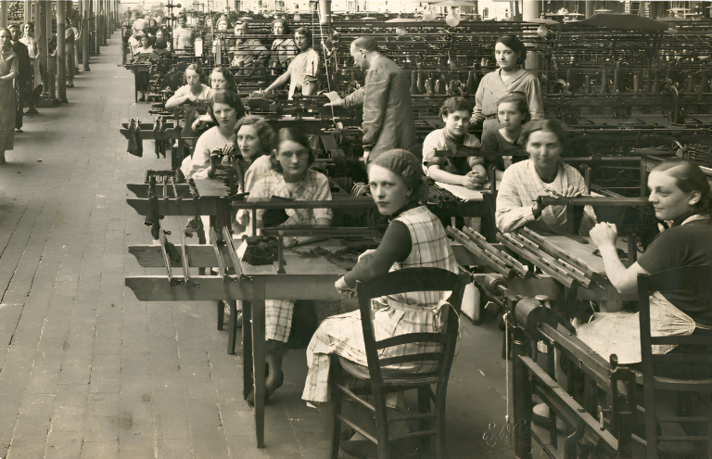
Roubaix
Photo credits: tissel.org

Slide 10
Roubaix
The building and the place are still called Tissel, in homage to this former textile factory of Roubaix. The place is inhabited, because here we talk about ‘inhabitants’ who will make this a place full of history again.”
- Guillaume Delbar, mayor of Roubaix

Slide 11
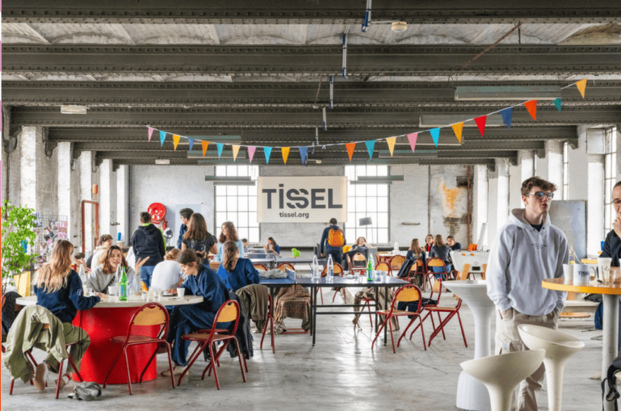
Photo credits: tissel.org

Slide 12
CCRI Testimonies
HASSELT
ROUBAIX
CITIZEN-LED INITIATIVES, ENTREPRENEURS
awareness
strategy
budget
trust
CITY & ORGANISATION
lack of awareness
no strategy
no budget
scepticism
CITY & ORGANISATION
awareness
strategy
budget
trust
CITIZENS, ENTREPRENEUS
lack of awareness
no strategy
no budget
scepticism
External drivers to address internal barriers
Internal drivers to address external barriers

Slide 13
No circular economy without a circular society
Circular economy: closing, narrowing, slowing, and regenerating material loops
Circular society: a necessary condition for a circular economy
Social equity, and meaningful participation.
Institutional, cultural, and organisational arrangements that structure how people live, work, produce and exchange.
Importance of a just circular economy
Distributive justice
Procedural justice
Recognitional justice
Who gains and who carries? burdens
Access, affordability, exposure to risks
Jobs and income quality
Who participates in decisions?
Transparency, accountability, voice
Co-design and shared monitoring
Whose needs and practices count?
Visibility of informal and community work
Respect for cultural and lived knowledge

Slide 14
Social hotspots in a circular transition
Workers
• Low pay and precarious contracts in repair, reuse, and waste management
• Health and safety risks in the informal circular economy
Local communities
• Unequal exposure to waste and processing infrastructure
• Land and resource pressures linked to critical materials and exports
Society
• Benefits concentrated in high-capacity regions and institutions
• Community knowledge under-used in policy and innovation
Consumers
• Risks in secondary markets and unequal access to information
• Digital privacy and data governance gaps in service models
Value chain partners
• Uneven playing field for SMEs, social economy, and informal actors
• Standards and IP regimes can block repair and reuse

Slide 15
Why circular initiatives do not reach everyone
Awareness and information gaps
Trust gaps, including past experiences with institutions
Access barriers: mental bandwidth, time, mobility constraints, digital exclusion
Affordability barriers: costs of repair, deposits, subscription fees
Habits and social norms: behavioural switch costs, stigma linked to reuse goods
Safety and quality concerns

Slide 16
Governance challenges for circular initiatives
Skills gaps:
behavioural insight
community engagement
monitoring and evaluation
Short project cycles
Lacking business models: long term desirability, feasibility, and viability
Siloed responsibilities across waste management, social policy, mobility, housing, …
Procurement and compliance constraints that favour lowest cost solutions (⬄ life cycle perspective)
Limited regulatory room for experimentation

Slide 17
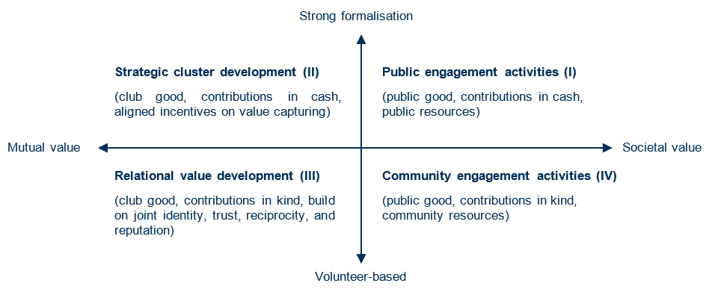
Governance challenges for circular initiatives
Van Opstal, W., Bocken, N. & Brusselaers, J. (2025), Unlocking the social circular economy: value propositions and organizational design of social circular hubs. Business Strategy and the Environment. https://doi.org/10.1002/bse.70138

Slide 18
Path dependencies
Negative loop
Positive loop
Low trust and low access
↓
Low participation
↓
Weak legitimacy
↓
Low institutional investment
↓
Fragile initiatives
Trust-building partnerships
↓
Higher participation
↓
Visible benefits and learning
↓
Stronger legitimacy
↓
More capacity and better design

Slide 19
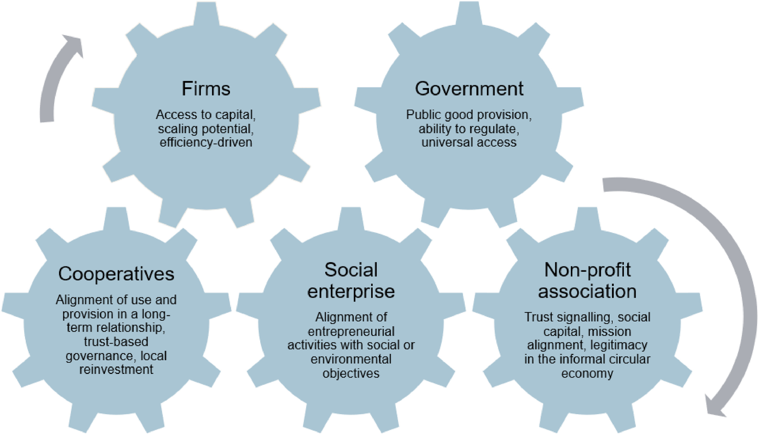
Embracing organisational diversity
Van Opstal, W., Bocken, N. & Brusselaers, J. (2026), Why organisational diversity matters in a circular economy and society. Resources, Conservation & Recycling, 229, 108833. https://doi.org/10.1016/j.resconrec.2026.108833

Slide 20

Your context – interactive exchange
Photo by DS stories on Pexels

Slide 21
What are you taking home?

Slide 22

Your context

Slide 24
Social barriers in circular transition
Internal barriers
External barriers
Negative reinforcement:
Public authorities & organisation
distrust & disengagement
Citizens & community
Lack of awareness and strategy
Lack of dedicated capacity & skills
Siloed departments and processes
Ad hoc responses
Risk aversion and budget constraints
Lack of awareness
Distrust in sharing/reuse initiatives
Rooted consumption habits
Feeling of exclusion from initiatives
Lack of accessible entry points
Scepticism towards city-led programmes
Positive reinforcement:
trust & growth
Drivers
Organisational system
Citizen lifeworld
Strategy – Budgets – Scalability - Accountability
Community – Trust – Care – Sharing – Small scale

