Slide 1

Circular Lifestyles in Action: Policy recommendations resulting from NiCE Pilots
NiCE Final Conference
11 March 2026
Max Kochański, Katarzyna Korczak Research and Innovation Centre Pro-Akademia, Poland

Slide 2
Plan
Introduction
NiCE Pilots overview
Work in groups: policy recommendations
Presentation of group work results and plenary discussion

Slide 3

What we want to achieve today:
reflect on what the NiCE pilots have taught us
move from practical experiences to policy implications
formulate concrete recommendations at local, national and EU levels
This is an interactive session.
Your experience and perspective are essential.
This Photo by Unknown Author is licensed under CC BY-SA-NC

Slide 4
what circular lifestyle is?
CIRCULAR LIFESTYLE @NiCE
community-based solutions embedded in city centres
linking environmental, social and economic value
activating underused spaces and local potential
everyday practices based on reuse, repair, sharing and responsible consumption
Focus: making circularity part of daily urban life.

Slide 5


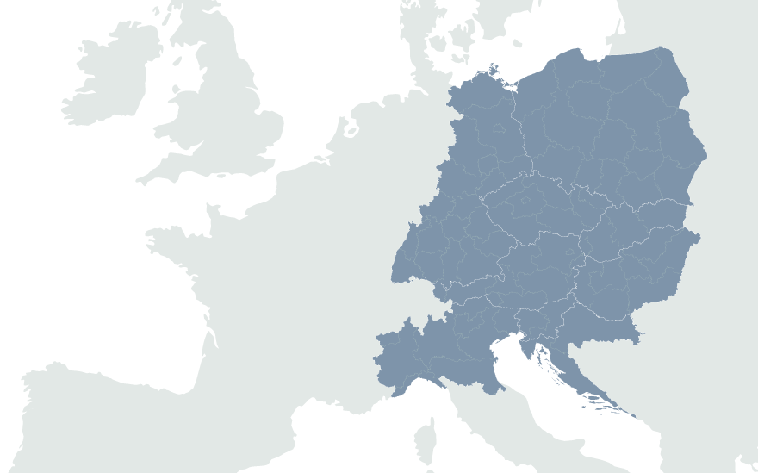


The NiCE pilots at glance
Resource Centres
Connecting online+offline trade
Brzeg Dolny, Poland (17,000 inhabitants)
Würzburg, Germany (population 130,000)
Ptuj, Slovenia (23,000 inhabitants)
Jihlava, Czech Republic (50,000 inhabitants)
Activation of vacancies
Activation of citizens
Kosice, Slovakia (230,000 inhabitants)
Budapest/ Ujbuda, Hungary
(143,000 inhabitants)
Graz, Austria (300,000 inhabitants)
Bologna, Italy
(387,000 inhabitants)

Slide 6
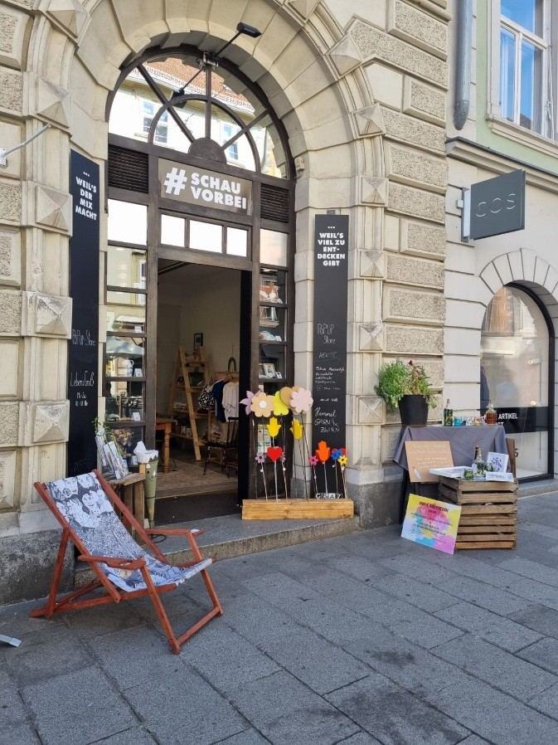
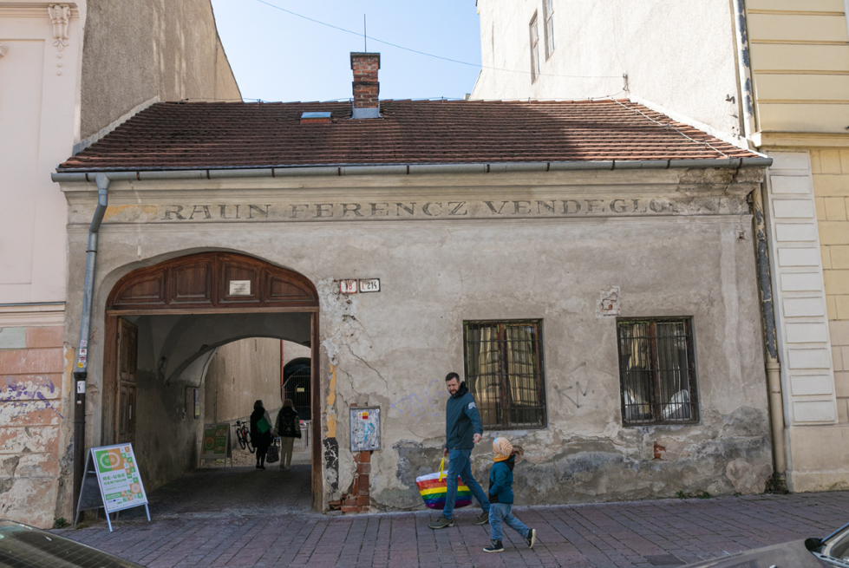
NiCE pilots at a glance
Core message: Vacant spaces can become visible hubs for circular entrepreneurship and community engagement.
Pilot 1: Initiate the reuse of spaces in city centres
Graz (AT) & Košice (SK)
Shared Focus: Activating vacant municipal spaces to make circular economy visible and accessible in city centres.
Circular lifestyle offers tested
circular pop-up store for CE products
upcycling workshops and demonstrations
cooperative shop-sharing model
testing a future permanent circular hub concept
Organisational model
SME-led, municipality-supported initiative
shared retail space for multiple entrepreneurs
collaboration with local circular businesses
Target groups
small circular entrepreneurs
city centre visitors
environmentally conscious consumers
local residents
Pop-up store in Graz
Circular lifestyle offers tested
collection and redistribution of second-hand items
educational and creative workshops
donation campaigns for social service providers
community events such as book swaps
Organisational model
NGO-led, municipality supported initiative
municipal building revitalized
operated by K13 – Košice Cultural Centres
cooperation with NGOs and social organisations
Target groups
local residents
NGOs and social service providers
workshop participants
broader public attending city events
Re-use Centre in Košice

Slide 7
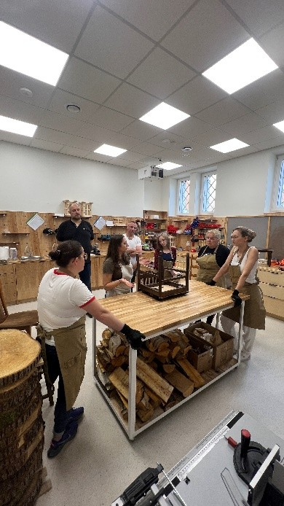
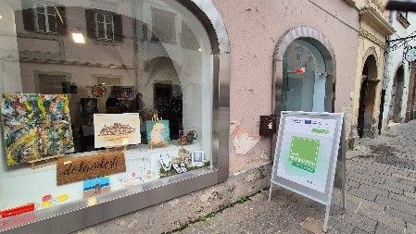
NiCE pilots at a glance
Core message: Multifunctional resource centres can strengthen local skills, social ties and circular practices.
Pilot 2: Implementation of resource centres
Brzeg Dolny (PL) & Ptuj (SI)
Shared Focus: Creating multifunctional circular hubs combining workshops, education and community building.
Circular lifestyle offers tested
sewing, carpentry and furniture renovation workshops
zero-waste cooking and children’s upcycling activities
volunteer-led handicraft sessions
Organisational model
Municipality-led initiative
cooperation between municipality, NGOs and local businesses
donations of surplus materials from companies
Target groups
local residents and families
children and youth
volunteers
Zero Waste Multicentre in Brzeg Dolny
Circular lifestyle offers tested
artisan and artist product showcases
awareness-raising events
inclusive workshops
Organisational model
city-supported temporary retail space
open platform for artisans, NGOs and citizens
cooperation with social institutions
Target groups
local artisans and creative community
city centre visitors, including tourists
NGOs
people with disabilities
Pop-Up Resource Centre in Ptuj

Slide 8
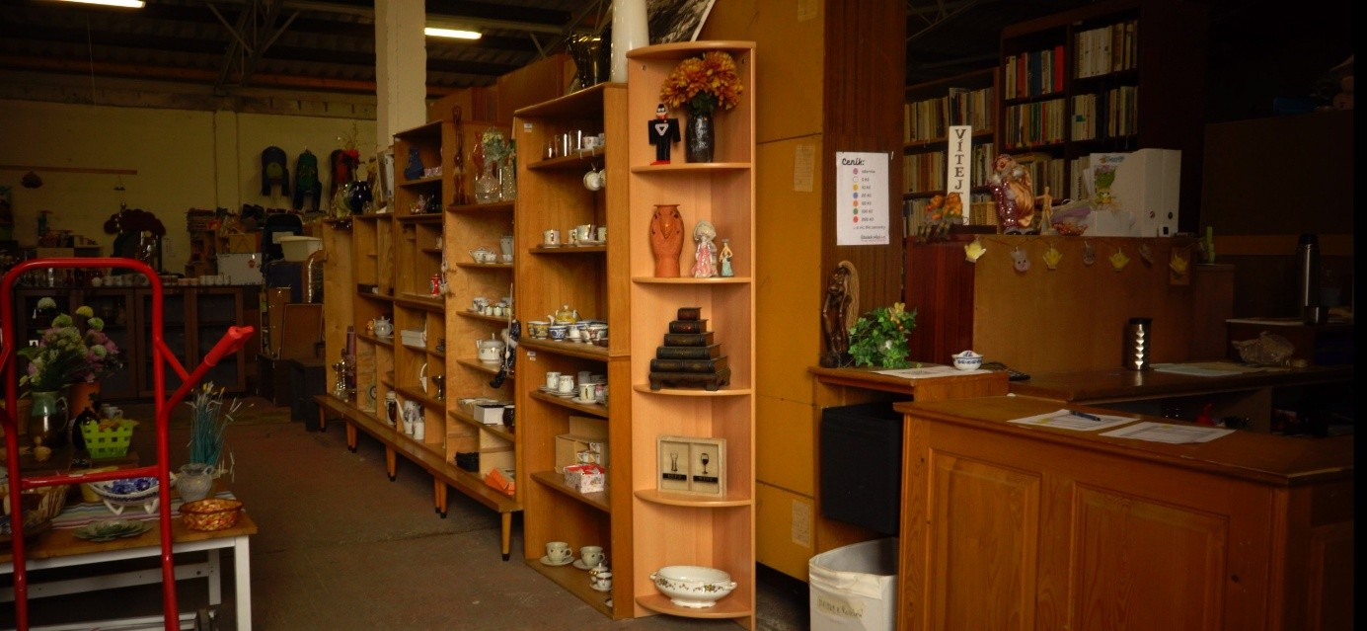
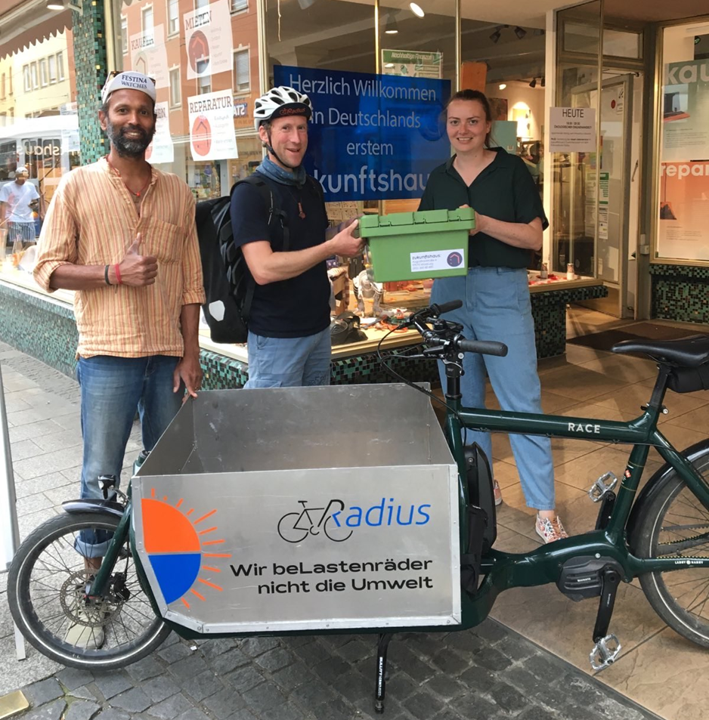
NiCE pilots at a glance
Core message: Technology and sustainable logistics can expand the reach and impact of circular services.
Pilot 3: Linking sustainable e-commerce with city centres
Jihlava (CZ) & Würzburg (DE)
Shared Focus: Connecting circular services with digital tools and new urban consumption patterns.
Circular lifestyle offers tested
digitalised reuse centre operations
electronic tracking of material flows
reuse days and awareness events
AI-supported item recognition tool
Organisational model
Initialized by SME
non-profit Silo Jihlava in cooperation with the city
collaboration with national Reuse Federation
integration of digital innovation into daily operations
Target groups
reuse centre users
staff and operators
citizens participating in reuse events
circular economy networks
SILO Jihlava
Circular lifestyle offers tested
CO₂-neutral bicycle delivery for rented and repaired goods
linking circular services with online platforms
stakeholder workshops and public promotion
Organisational model
Initialized by the governmental institution
partnership between NGOs and SMEs
advisory board and stakeholder engagement process
integration into existing sustainability initiatives
Target groups
residents outside the city centre
users of repair and rental services
ustainability-oriented consumers
Zukunftshaus in Würzburg

Slide 9
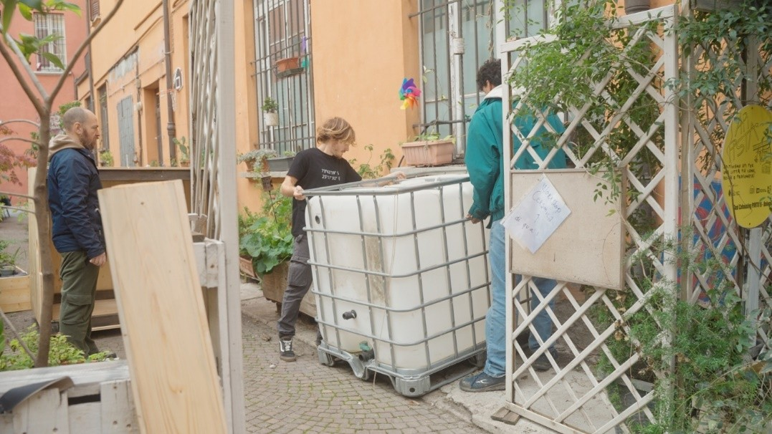
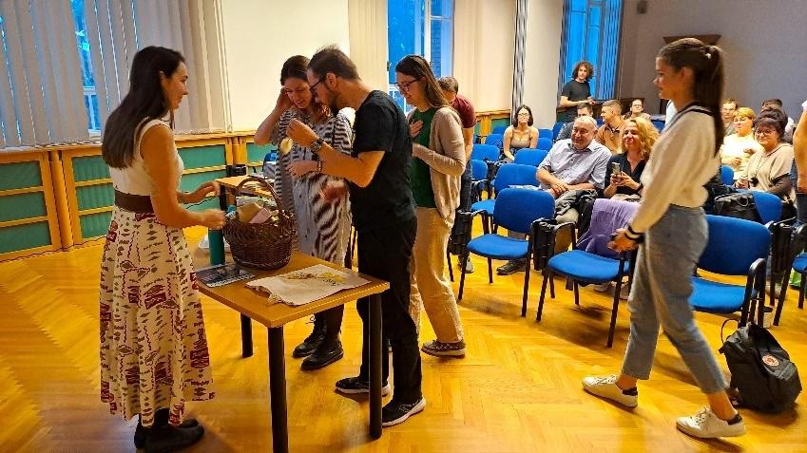
NiCE pilots at a glance
Core message: Citizen activation, education and co-creation are powerful drivers of circular lifestyles.
Pilot 4: Activation of users for circular lifestyles
Bologna (IT) & Budapest (HU)
Shared Focus: Engaging citizens in sustainable water use and broader circular behaviour change.
Circular lifestyle offers tested
Urban Living Lab with rainwater harvesting systems
School Living Lab on water conservation
hands-on co-design and awareness activities
Organisational model
Led by a sectoral agency
cooperation with municipality, university and community sites
integration of technical expertise and citizen engagement
Target groups
local residents
community gardeners
university community
elementary and middle school students
Circular water management in Bologna
Circular lifestyle offers tested
university living lab format
sustainable business model design course
collaboration with circular businesses
Organisational model
led by a public university
integration into higher education curriculum
cooperation with local circular enterprises
Target groups
university students
local citizens attending public events
partner businesses
academic community
Co-creation for More Circular Cities in Budapest

Slide 10
Group discussion: from pilot experience to policy recommendations
1.
Short introduction of the pilot:
-key elements of pilot activities
-main success factors
-barriers and limits encountered
2.
Which elements of the pilot could be replicatated in your city / region?
3.
What are enabling factors and barriers for replication of the pilot (or its elements) in your city / region?
4.
For wide-spread adoption of similar initiatives, what type of policy change is most needed at: -local level -national level -EU level?

Slide 11
Examples of policy changes
Regulation
Codes / standards / mandates
Ecodesign and durability standards for products (electronics, furniture, appliances)
Standards on repairability, modularity, and recyclability of products
Material passports for products
Mandatory circularity assessments in urban development and procurement
Audits of material flows in cities
Targets for circular public procurement
Municipal and regional waste reduction and recycling targets
Economic and financial instruments
Direct investment
Funding for multifunctional resource centres, repair hubs, and pilot circular lifestyle initiatives
R&D / Innovation funding
Support for circular economy demonstration projects in urban areas
Loans / soft loans
National or regional funds supporting repair, refurbishment, and local reuse initiatives
Market-based instruments
Circularity certification schemes for products and services
Regional circular economy credit systems for urban reuse networks
Fiscal / financial incentives
VAT reductions or tax credits for repair services, reuse, and sharing schemes
Subsidies for urban pilot initiatives implementing circular solutions
Soft instruments
Information campaigns
Educational and awareness campaigns on waste reduction, repair, reuse, and circular lifestyles
Quality assessment of CE campaigns to measure effectiveness
Performance / comparison labels
Circularity labels for products, services, and urban projects
Platform-based benchmarking tools for urban circular initiatives
Voluntary approaches
Public-private partnerships to support pilot circular lifestyle initiatives
Voluntary schemes for cities to adopt CE practices and share solutions
Citizen engagement projects co-created with local communities
Obligation schemes
Auditing / reporting requirements
Minimum reuse and repair quotas for manufacturers and municipalities

Slide 12
FEASIBILITY
IMPACT

Slide 13

Let’s work in groups!
This Photo by Unknown Author is licensed under CC BY-NC

Slide 14

RULES
Be respectful to others
Use plain language, avoid jargon or acronyms
Follow the law of two feet: if you feel you’re not learning or contributing, feel free to move to another group
This Photo by Unknown Author is licensed under CC BY-SA-NC

Slide 15

Research and Innovation Centre Pro-Akademia
Poland
https://www.proakademia.eu/en/
katarzyna.korczak@proakademia.eu
maksymilian.kochanski@proakademia.eu
+48 42 636 12 59
www.facebook.com/ProAkademia
twitter.com/CBI_ProAkademia
www.linkedin.com/company/research-and-innovation-centre-pro-akademia/
youtube.com/@ProAkademia

