Slide 1
NiCE Conference at the UMWELTBUNDESAMT
A virtual and interactive city walk through the in-house research project AdNEB II
Workshop 1
Karl Eckert und Moritz Kasper, FG I 2.5 – Sustainable Spatial Development, Environmental Assessment
Pia Runge, FG III 1.4 – Substance-related Product Issues

Slide 2
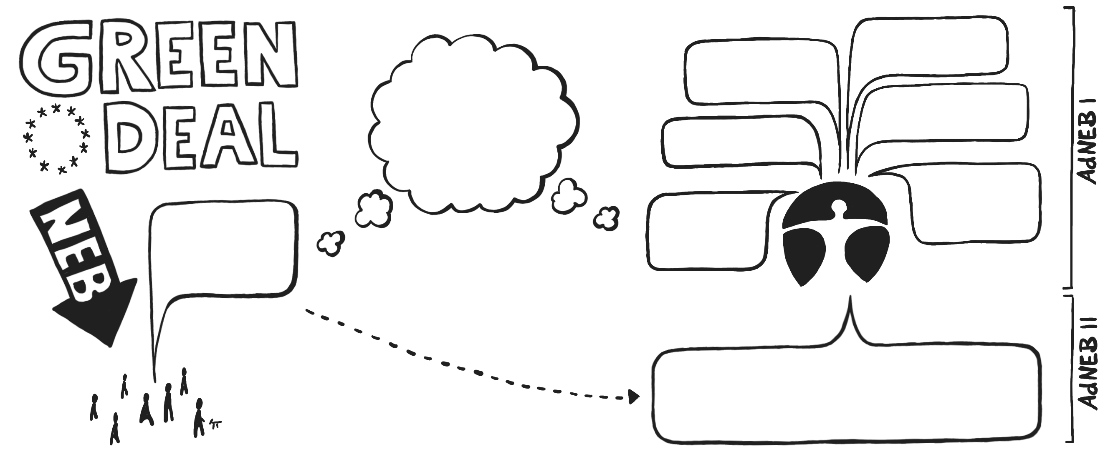
Advancing the new european bauhaus (AdNEB)
Environmental Justice
Green and Recreational Spaces
SUSTAINABLE
BEAUTIFUL
TOGETHER
Affordable Housing
Health
and Wellbeing
Active and Sustainable Mobility
How do we want to live?
Climate
Change Adaptation
GUIDING
QUESTION
Engage in Dialogue, form Allies of Interest,
join Forces and adress the Subject of Aesthetics

Slide 3
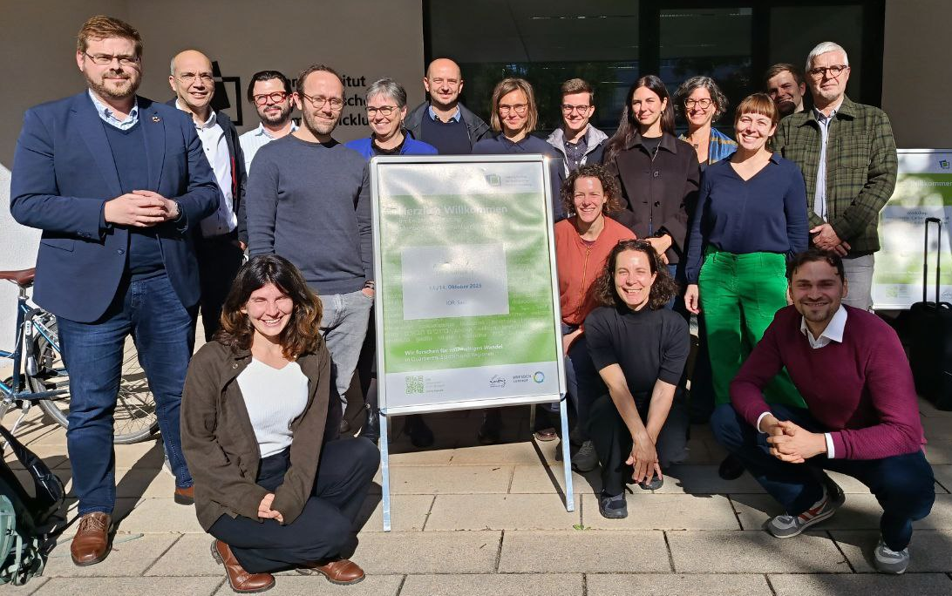
A virtual and interactive city walk through the in-house research project AdNEB II
URBAN RENOVATION
ENVIRONMENTAL JUSTICE
INTERNATIONAL AFFAIRS
ENVIRONMENTAL URBAN DEVELOPMENT
SPONGE CITY
Team
AdNEB II
SECTIONS
I 2.5, I 2.6,
I 2.8, II 1.1
and III 1.4
MOBILITY
ENVIRONMENTAL JUSTICE

Slide 4


Quick „get-to-know-each-other“
A virtual and interactive city walk through the in-house research project AdNEB II

Slide 5
Workshop plan
A virtual and interactive city walk through the in-house research project AdNEB II
Round 1 – 15 Minutes
Identify, discuss, and make visible deficiencies, problems, and inequalities at each table and within the respective urban scene.
Materials: pens, tracing paper, glue, scissors, etc.
Presentation – 5 Minutes
Presentation by the groups of the problems identified in the urban scene and illustrated, for example, as collages; 2 minutes per table.
Round 2 – 25 Minutes
Identify, discuss, and make visible solutions and, where applicable, conflicts within “expert teams.”
Materials: pens, tracing paper, glue, scissors, etc.
After 7 minutes, the teams change tables and move (quickly) clockwise to the next urban scene to contribute their perspective there.
Presentation – 10 Minutes
Presentation by the groups of the solutions, synergies, and conflicts identified in the urban scene and illustrated, for example, as collages; 3 minutes per table.

Slide 6
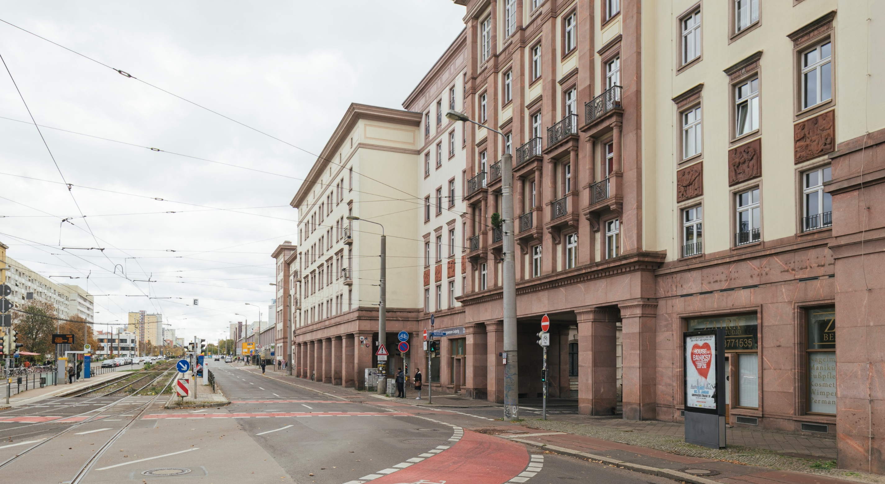
Scene 01
A virtual and interactive city walk through the in-house research project AdNEB II
Leipzig, 51°19'59.4"N 12°22'37.3"E
Kreuzung Windmühlenstraß+Grünewald-straße+Härtelstraße
Foto: Joshua Delissen

Slide 7
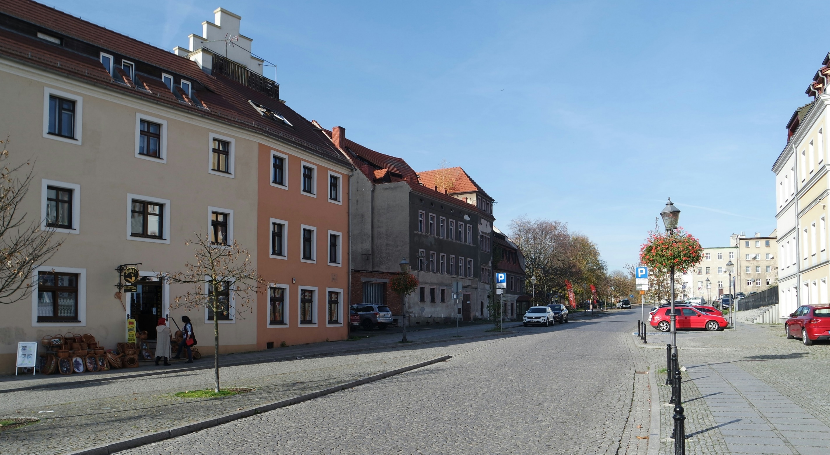
Scene 02
A virtual and interactive city walk through the in-house research project AdNEB II
Zgorzelec,PL, 51°09‘28.74"N 14°59‘40.62"E
Wrocławska 1
Foto: Aleksei Tertychnyi

Slide 8
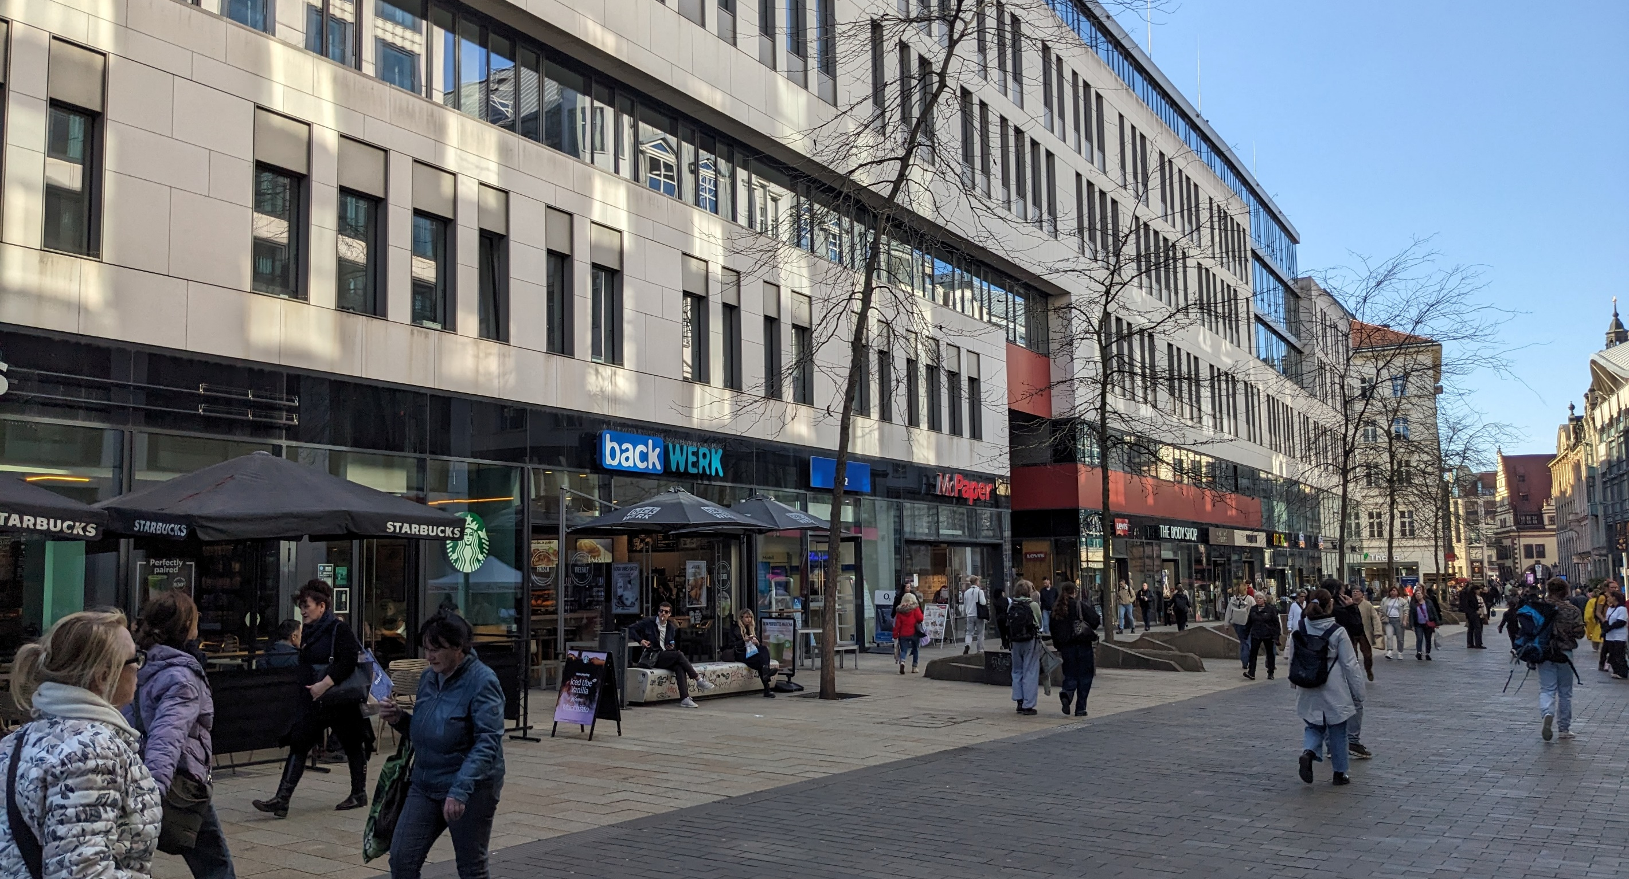
Perspektive 04
A virtual and interactive city walk through the in-house research project AdNEB II
Scene 03
Leipzig,DE, 51.339535“N, 12.379246“E
Grimmaischer Strasse 29
Foto: Karl Eckert
Nairobi, 1°17'32.6"S 36°47'14.5"E
Kreuzung Argwings Kodhek Road+Ring Road Kilimani
Foto: Moritz Kasper

Slide 9
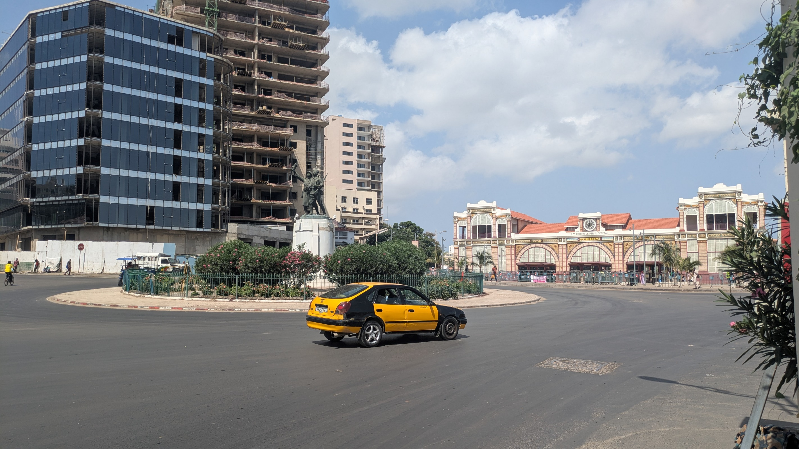
Scene 04
A virtual and interactive city walk through the in-house research project AdNEB II
Dakar,SN, 14.675311, -17.432805
Bd de l'Arsenal
Foto: Moritz Kasper

Slide 10
Keywords of the City Walk
A virtual and interactive city walk through the in-house research project AdNEB II
Reuse/ Repurpose
Historic preservation
Green roofs
Flood retention
Bike lanes
Nature-based solutions
Environmental and Climate Justice
Inner urban development
Community meeting places
Renovation
Common good and community services
Participation
Tree plantings
Desealing
Vertical building extensions
Water swales
Proximity
Play areas
Green facades
Intervention
Accessibility
Parking
Street trees
Building extensions
Consumption free places
Material choice

Slide 11
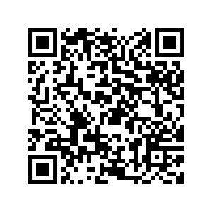
Thank you for your attention!
Karl Eckert, FG I 2.5, karl.eckert@uba.de
Moritz Kasper, FG I 2.5, moritz.kasper@uba.de
Pia Runge, FG III 1.4, pia.runge@uba.de
Advancing the New European Bauhaus
short: AdNEB
https://www.umweltbundesamt.de/en/research-project-adneb-advancing-the-new-european

